Slide 2
Snowboard
Welcome to the 2019-2020 Season

Slide 3
Manage Concussions
TBI/Concussion Info
Proper Helmet&Mouth Guard
“When in Doubt… Pull them Out”
Colorado State Law
Return to Sport Protocol
Limit Physical and
Cognitive Stress
Remove from Training/Comp
Follow -Up Care Very Important
Be Patient - 4 -6 weeks recovery is common
Understand the symptoms
Have Fun Be Safe

Slide 4
SafeSport
What is it?
The MAAP
Compliance is changing
Help us
include another adult on communications with minors
Turn in travel waivers in timely manor
Monitor you kids texts
Safesport.org

Slide 5
Programs
Intro to Team Summit every Saturday for 15 weeks at a mountain of your choice
Snowboard 101 Saturday and 3 sundays/month for 15 weeks. Travels to different mountains in summit county.
Snowboard 201 Saturday and Sunday, Fridays available. Travels to different mountains in summit county
Snowboard 301 Saturday and Sunday, Fridays available. Travels to different Mountains
Academy year round opportunity. 5 days/week
Notes:
big mountain?

Slide 6
Meeting Locations
Copper- 9:00 Eagles Landing behind the Eagle Chair
Breckenridge- 9:00 Base of Peak 8 Ski hill grill, Intro meets at Copper Top on Peak 9.
Keystone- 9:00 Base of Peru Chair, Mountain House
Bring a backpack with a lunch, water, sunscreen, extra layers. Packs will be stored on the mountain.

Slide 7
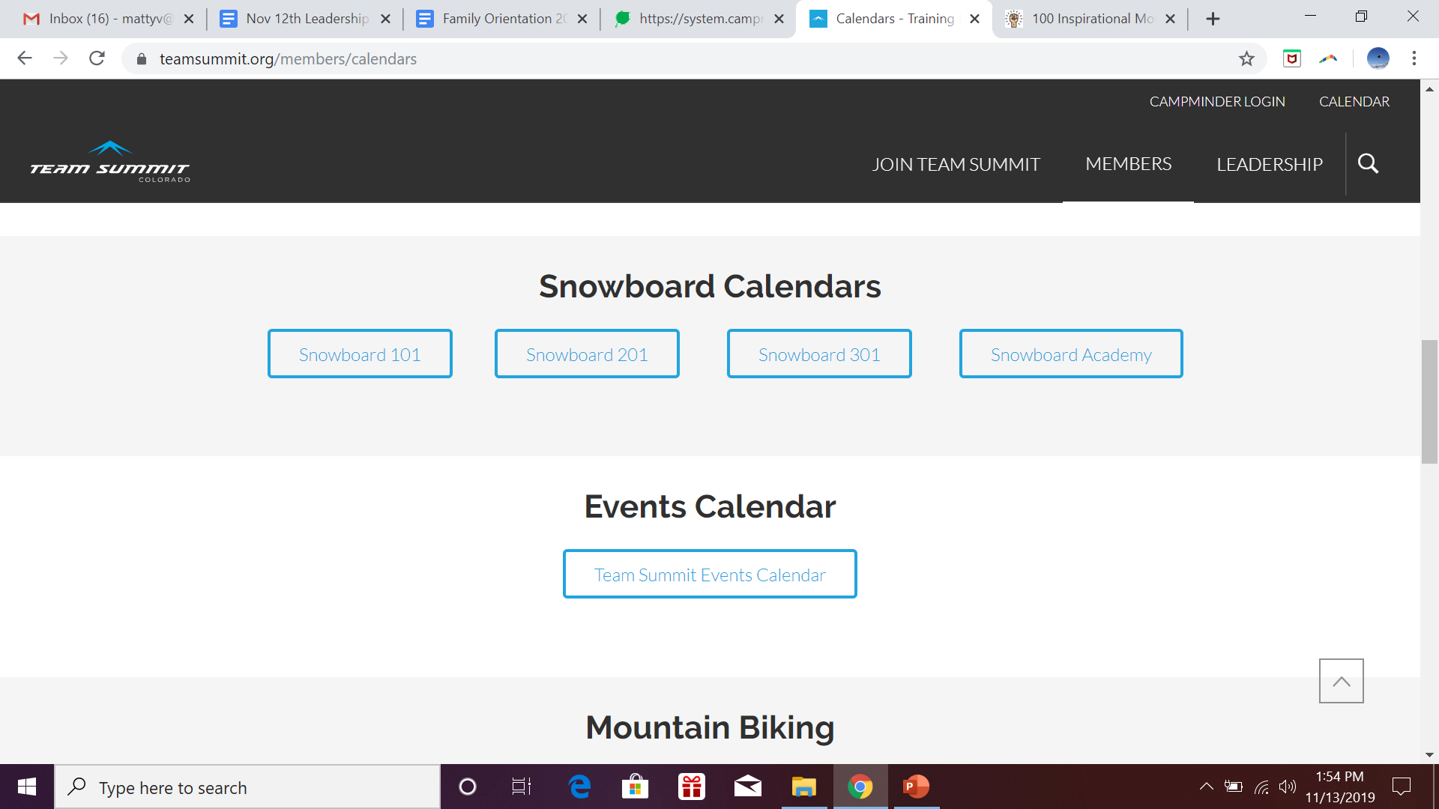
Calendars

Slide 8
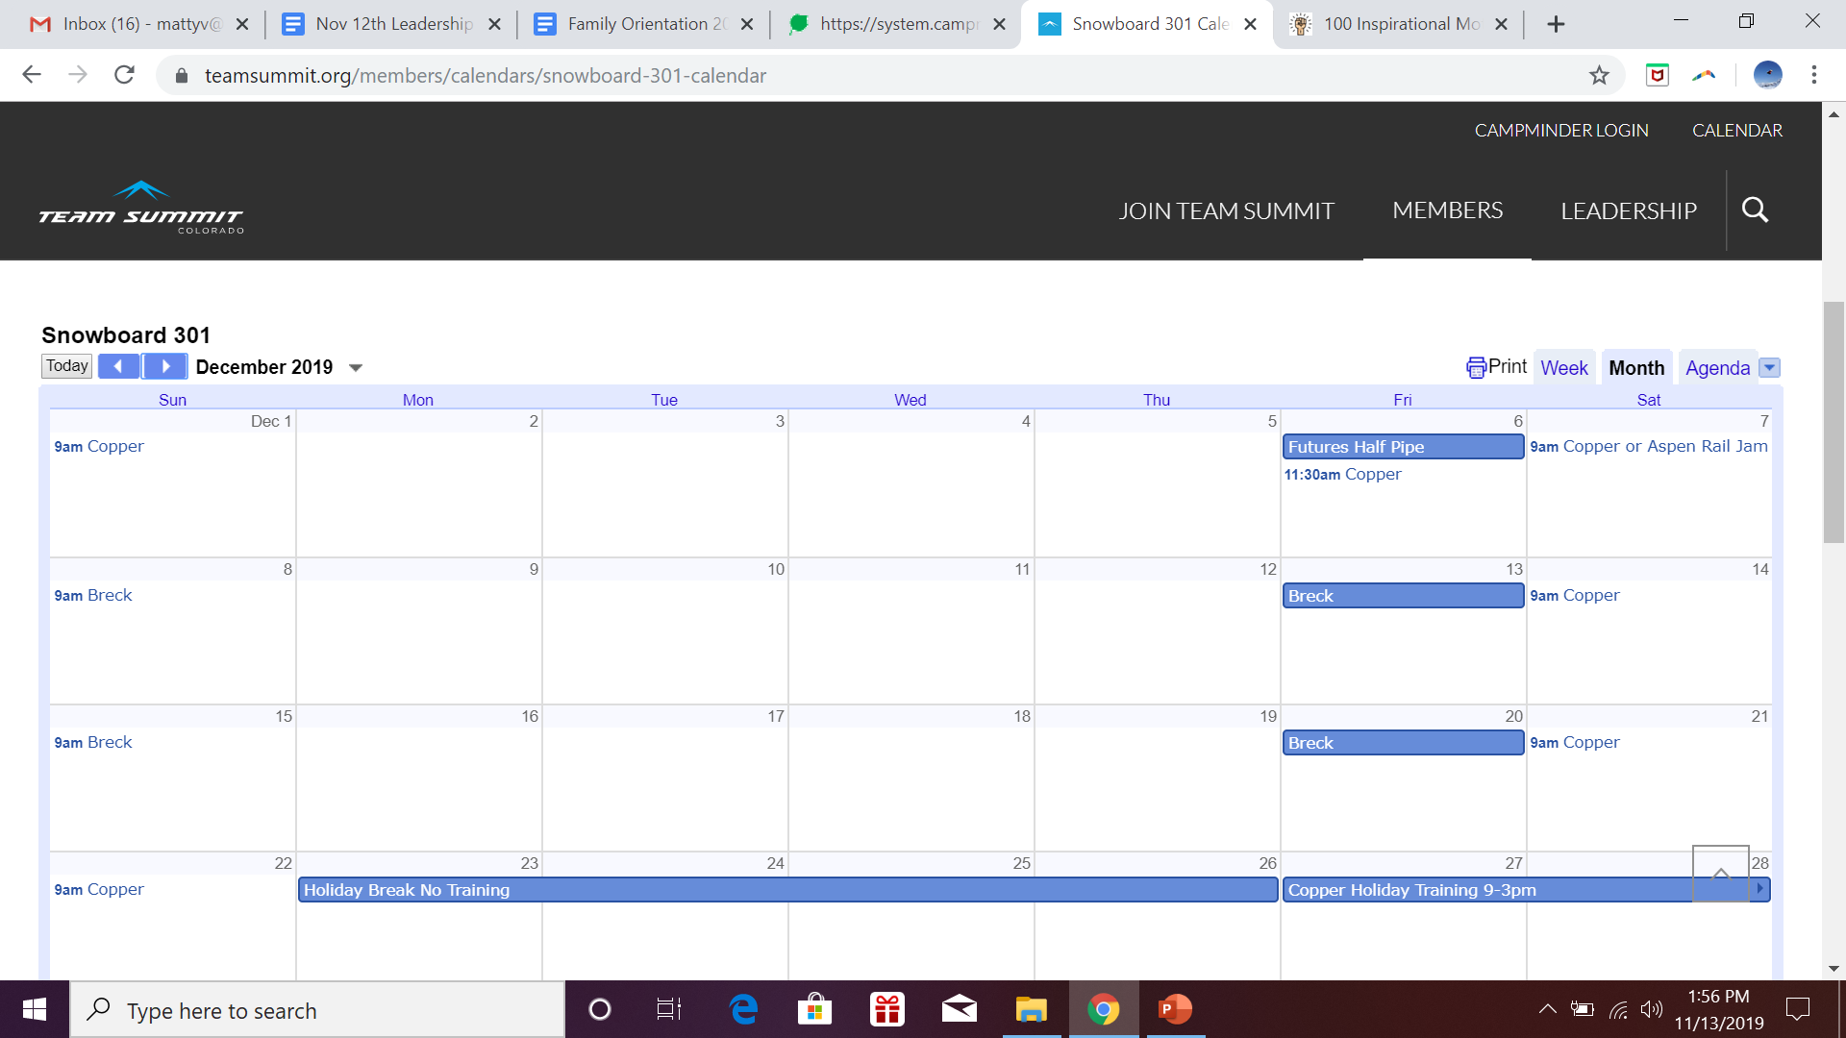

Slide 9
USASA and Rocky Mountain Series
USASA is the organization usasa.org
Rocky Mountain Series (RMS) is the contest series for Slope, Pipe, BoardX, Rail Jam rockymountainseries.com
101- Competes in Summit County events
Comp-Competes all RMS events and more

Slide 10
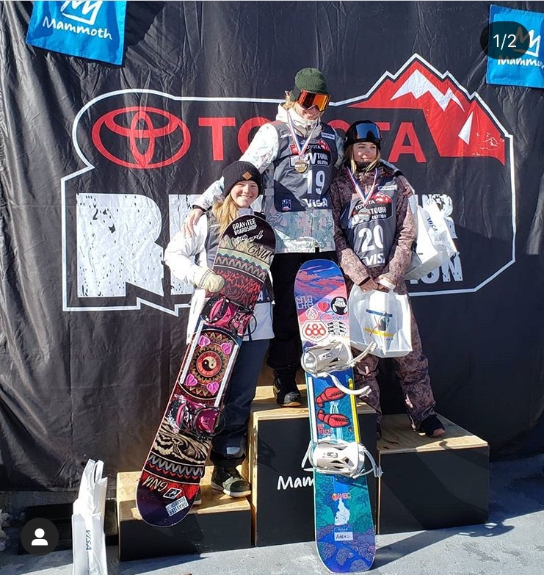
Futures Tour
Copper Dec. 5th
Copper Feb. 24th
Park City March
Mammoth?

Slide 11
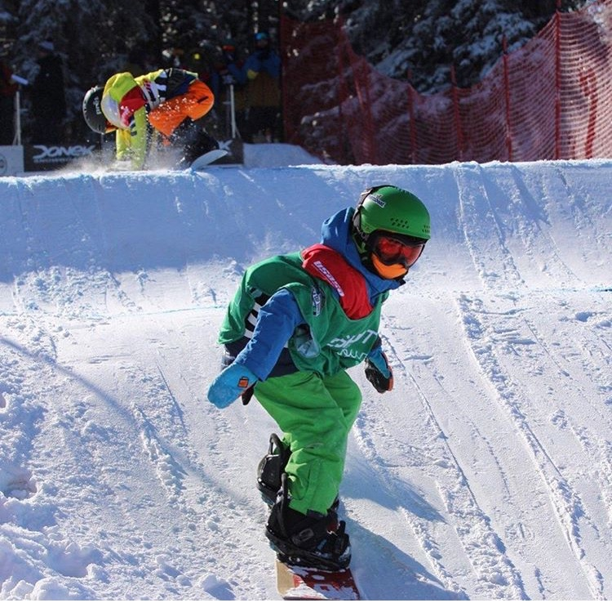
BoarderX
More Training days at Ski Cooper
Lane Space at Keystone
USASA at Ski Cooper
Rev Tour at Ski Cooper
Rev Tour at Gore
USASA at Crested Butte

Slide 12
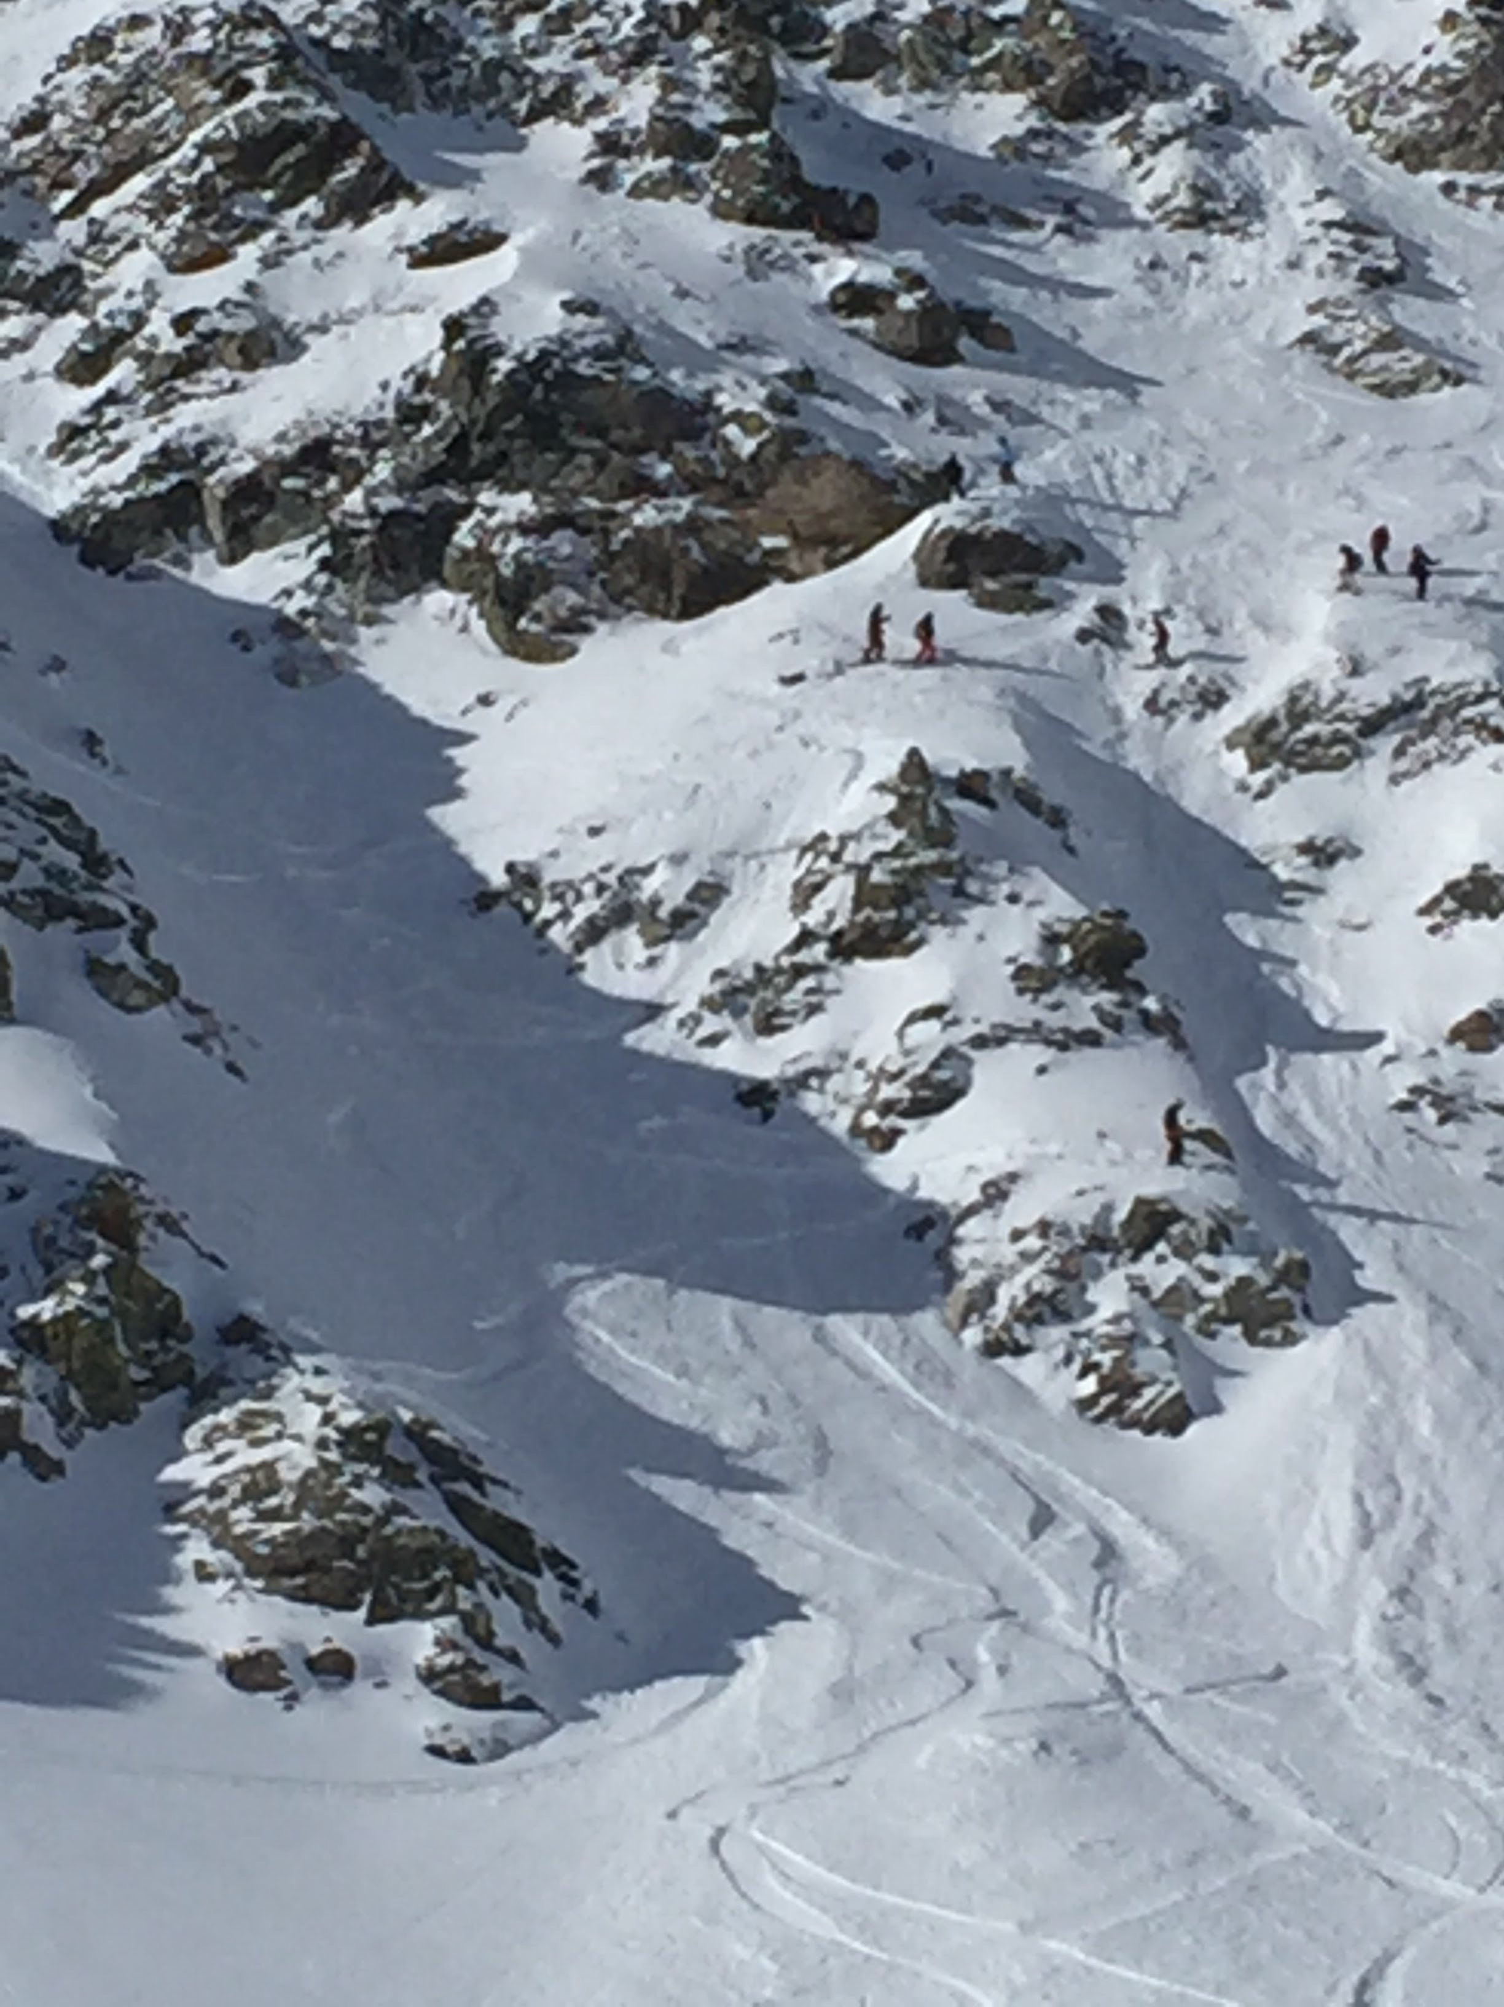
IFSA
What is It?
International Freeskiers and Snowboarders Association freeskiers.org
big mountain
U12 Divisions

Slide 13
Travel Policy
no travel is included for intro programs
Travel, perdiem is included to RMS (SS,BX,HP) events for comp programs (201,301,academy)
Lodging not included
Silverton Ex:
300 miles driven- 1.20/mi divided by # of athletes
Food expense/# of athletes
Lodging expense/#of athletes
coach per diem/# of athletes

Slide 14
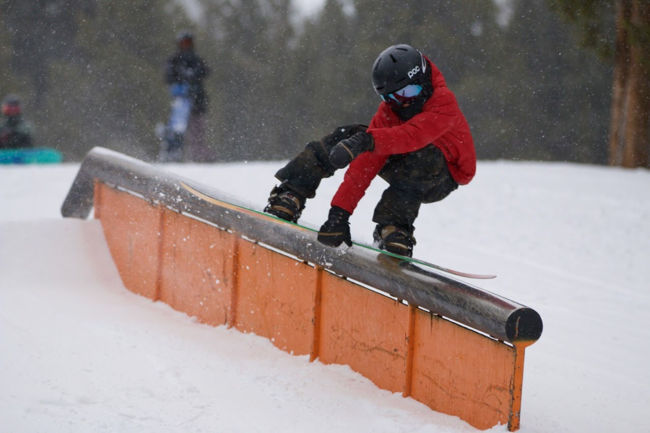
Rules
Helmet buckled
Big mountain Back protectors
No inverts in big mountain
Stay in course
Board must be attached

Slide 15
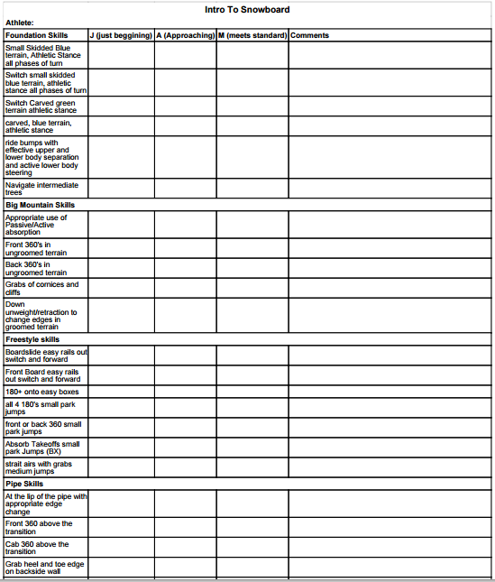
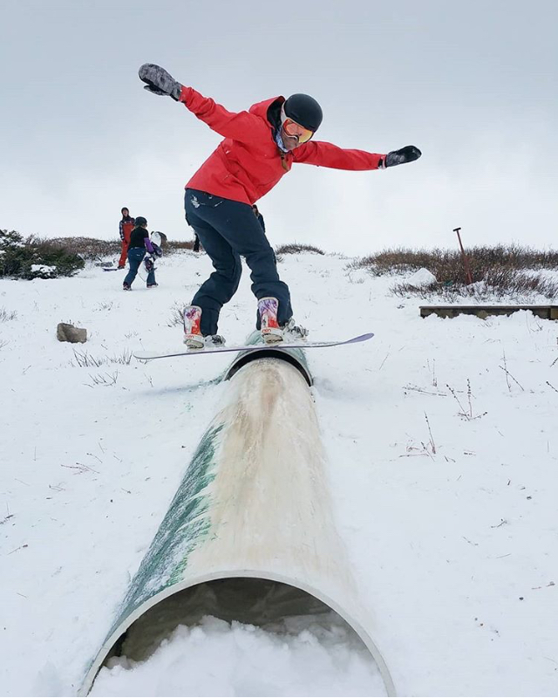

Slide 17
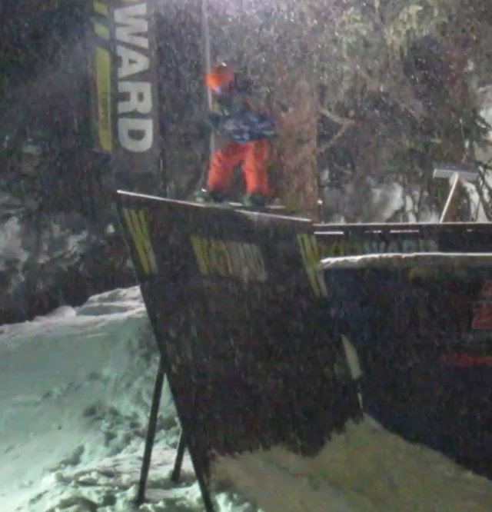
How Parents Can Help

Slide 18
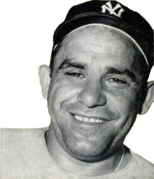
“Baseball is 90% mental and the other half is physical” “If you don’t know where your going, you will end up some place else.” Yogi Berra
Mental Training

Slide 19
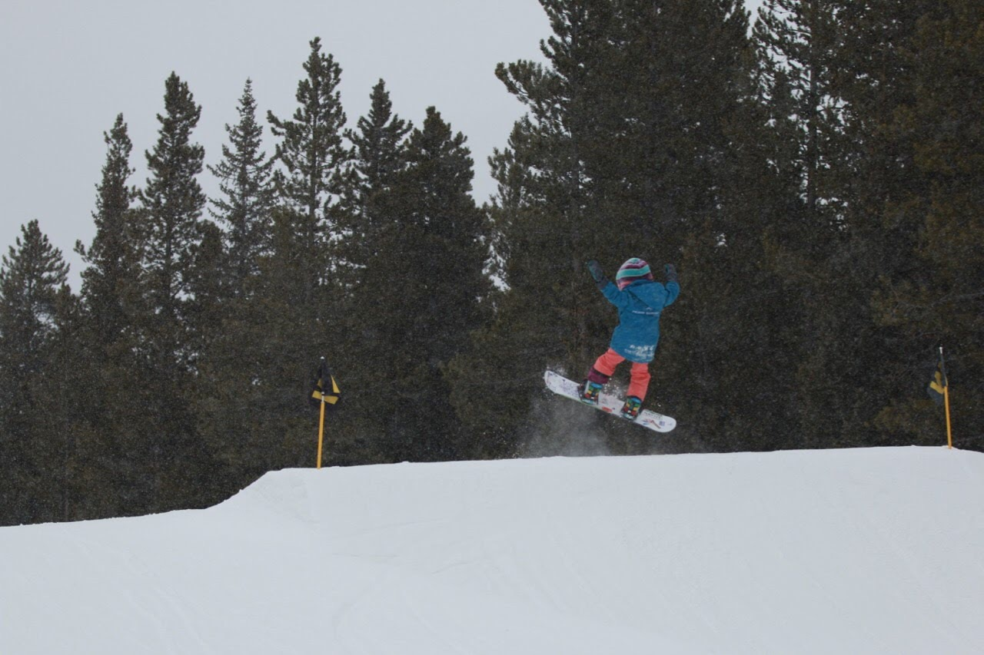
How parents Can Help
1. Encourage Positive Self Talk.
Positive talk does not guarantee good performance but negative talk guarantees poor performance.

Slide 20
How parents Can Help
2. Praise your child for their effort more than the result. Tell them you love to watch them ride.

Slide 21
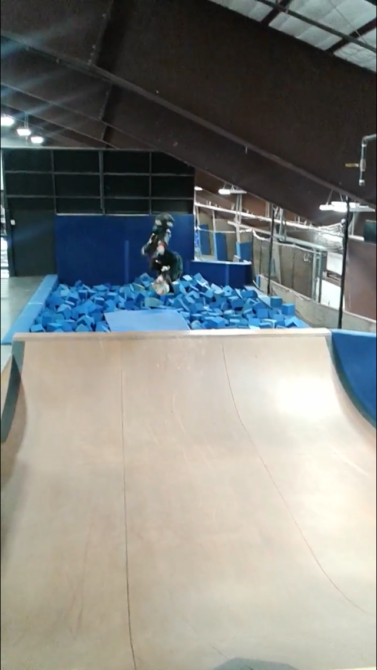
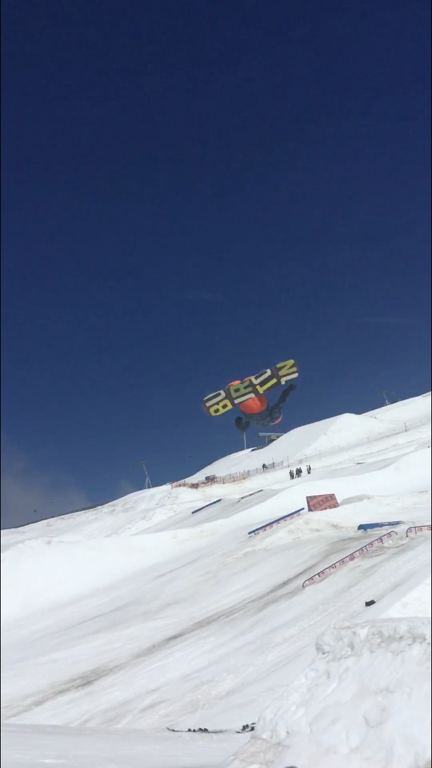
How Parents can help
3. Snowboarding is FUN!!Fun changes throughout the kids snowboard career. One path we talk about is snowboarding is fun, training is fun, competing is fun, winning is fun.

Slide 22
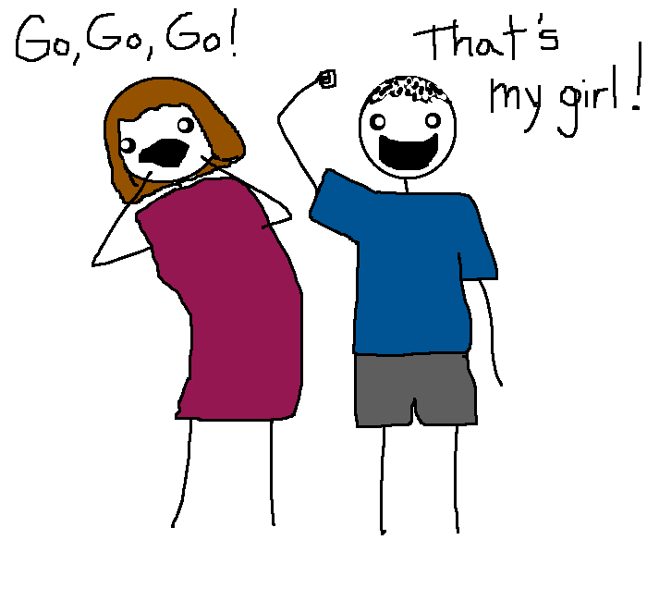
what Parents Should Do
-Support Coaches, kids, and each other.
-Provide Healthy lunches for their little athletes
-Have kids arrive on time.
-communicate with the coach
-Observe Training from the sidelines
-cheer.

Slide 23
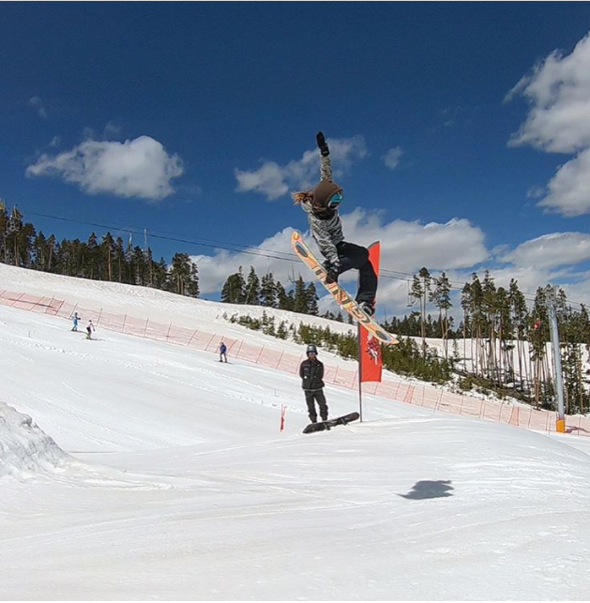
What Athletes should do
-Show up on time.
-listen and apply feedback
-focus on their daily goals
-Be a role model for all riders
-Respect all Team Summit Athletes
-Represent snowboard Athletes
-Keep equipment in good shape.

Slide 24
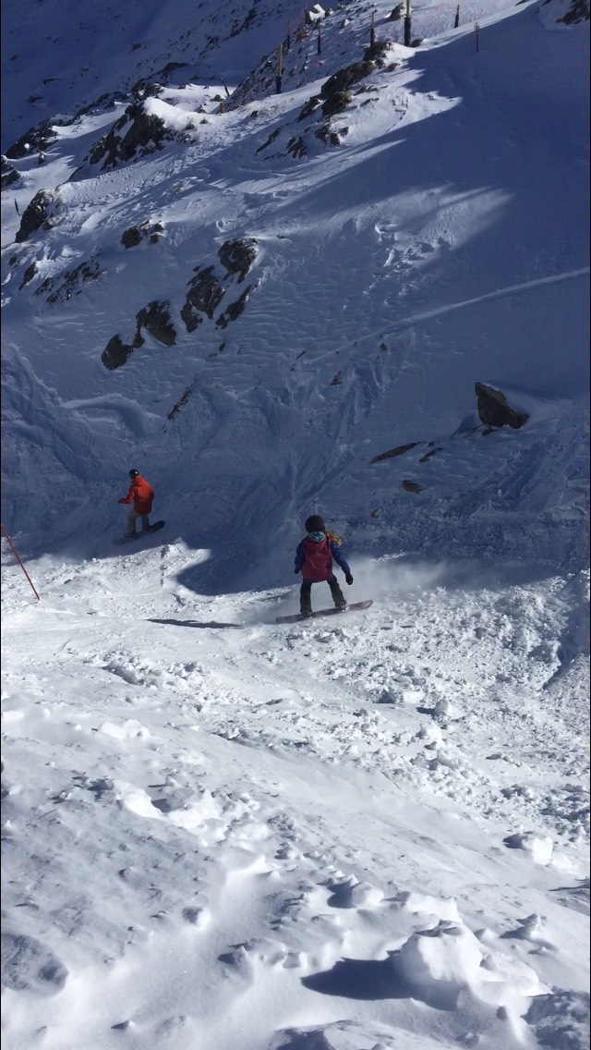
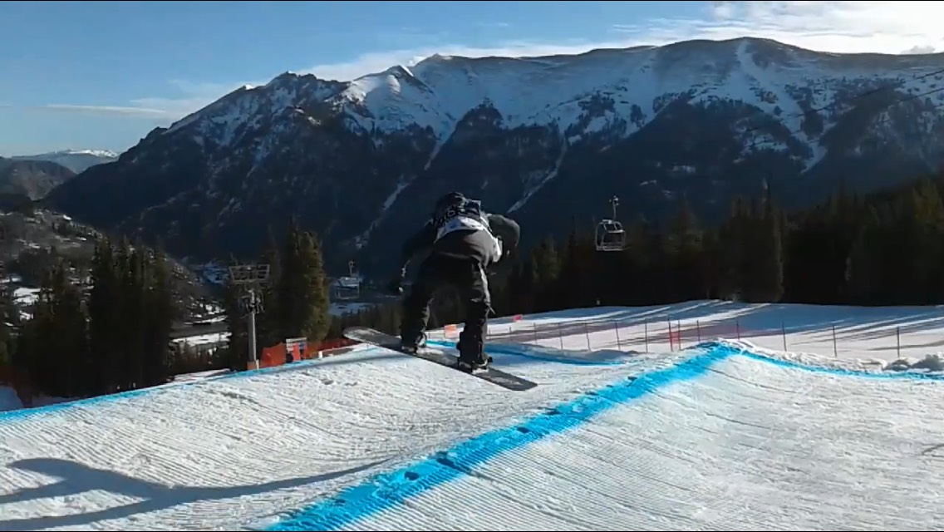
Coaches Responsibilities
-Communicate with Athletes and Parents
-Provide effective feedback/preparation for training and competition
-Keep training safe and fun
-Safesport and Heads Up
-Show up on time

Slide 25
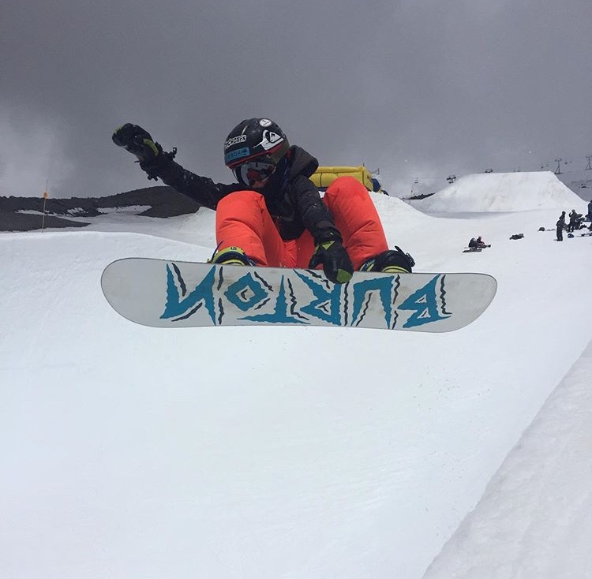
Summer Camps
Woodward Camp June
Mt Hood 2 camps
Airbag 2 Camps
Skateboarding

Slide 26
Questions?

