Slide 1
Team Summit Freeski
Intro to Freeski
Big Mountain
Moguls
Park & Pipe
Academy

Slide 2
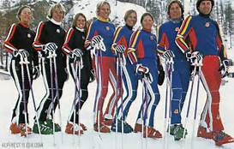
TSC Long History est. 1970’s
Board of Directors
Sub committees
Executive Director
3 Program Directors
85 coaches
480 athletes
My 21th season

Slide 3
Mission We are a youth development organization empowering our athletes to realize and celebrate their personal podiums through athletics, education, and life skills by participating in innovative programming at our world class venues.

Slide 4
Core Values Excellence Respect Integrity Responsibility Fun Family Vision whole athlete | whole team | whole community

Slide 5
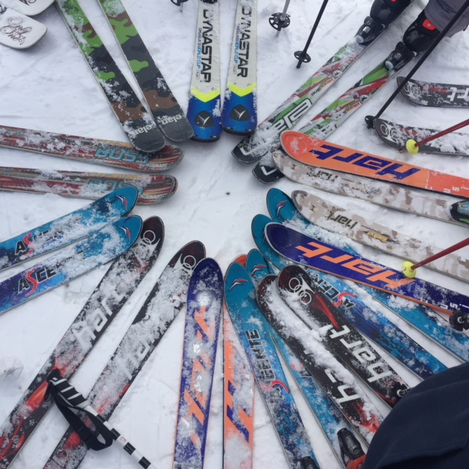
Personal Podiums
Long Term Athlete Development
Play based Skill acquisition
2018 Olympics -Norway Model
Terrain Variations
Age Appropriate Courses
Increase intensity with Development
Cheer for the whole team
Go to Awards
Look for daily goals
Acknowledge good behavior
Have Fun Be Safe!

Slide 6
Athletic Development
Have great Coaches! Keep Training Fun!
Sportsmanship
Year-round Aerial development
Mental Training
Dynamic Balance
Foot speed
Strength
Personal Podiums

Slide 7
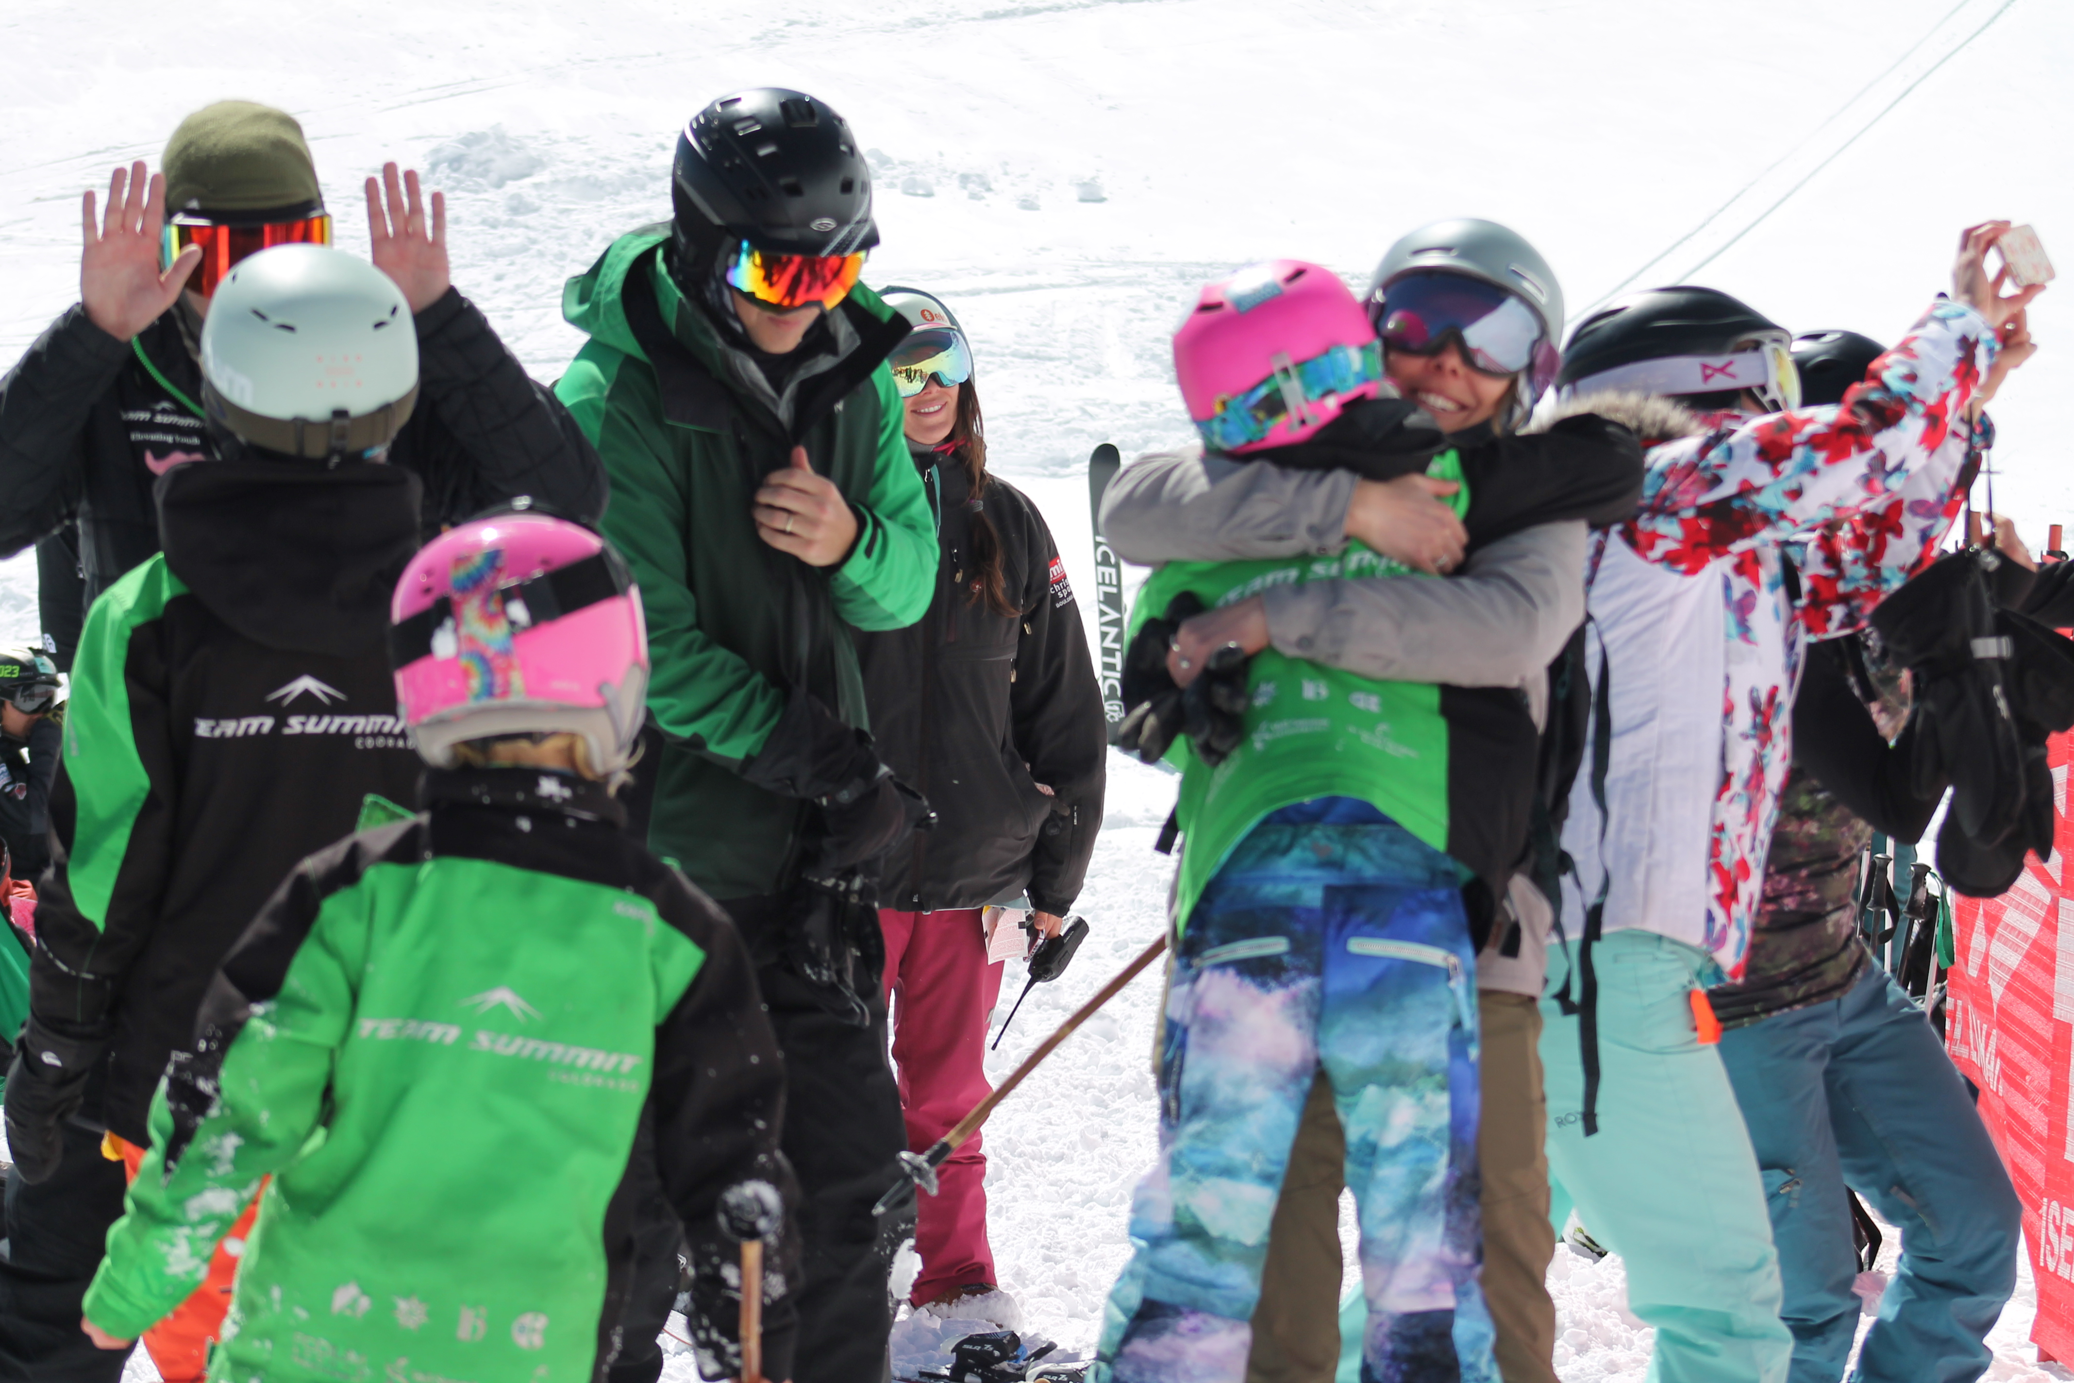
“Real Skiers Bus their own table”
Athlete Responsibilities
Respect Mountain Operations
Be Safe- Manditory Comfort Bar
Listen to Coaches and Staff
Take Care of Equipment
Wear Your Team Summit Jacket with Pride
Be supportive of each other
Know the Code
Ask questions
Communicate
Have Fun Be Safe!

Slide 8
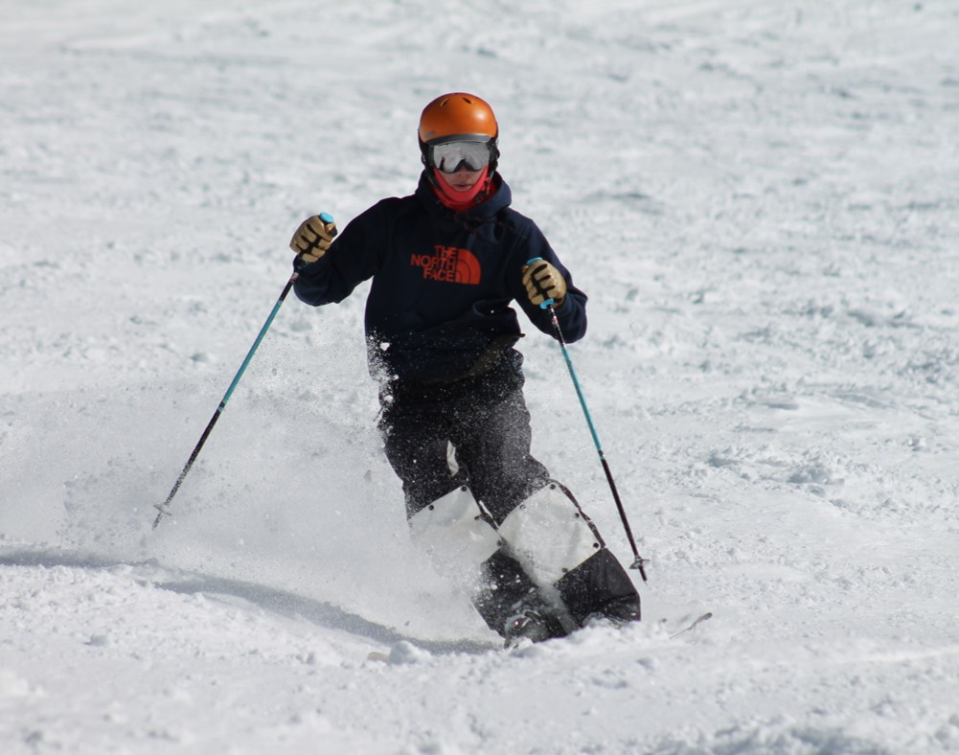
Skiing is an Individual Sport best practiced with a team
Athlete Responsibilities
Be on Time
Be properly Dressed
Sunscreen, face protection
Layers, hand warmers,
Be Rested and Ready
Stay Hydrated and fueled
Honest Effort
Team Spirit
Cheer each other on
Help each other out
Be positive
It Isn’t always easy

Slide 9
Unique Training Venues
Copper
Arapahoe Basin
Keystone
Breckenridge
Copper
Frisco Adventure Park
Woodward
Team Trampolines

Slide 10
Year Round Training
Sept 4 Academy Program starts
Oct 20th On Snow Copper Mountain
Nov 18 Weekend Programs start
Dec 2 Intro Program Start
April 14th Programs End
April 28th Spring Camps
May - Camps
June 15-30 Mount Hood
H20 Steamboat- ongoing
July 25 -30 UOP
Aug 3-18 Chile

Slide 11
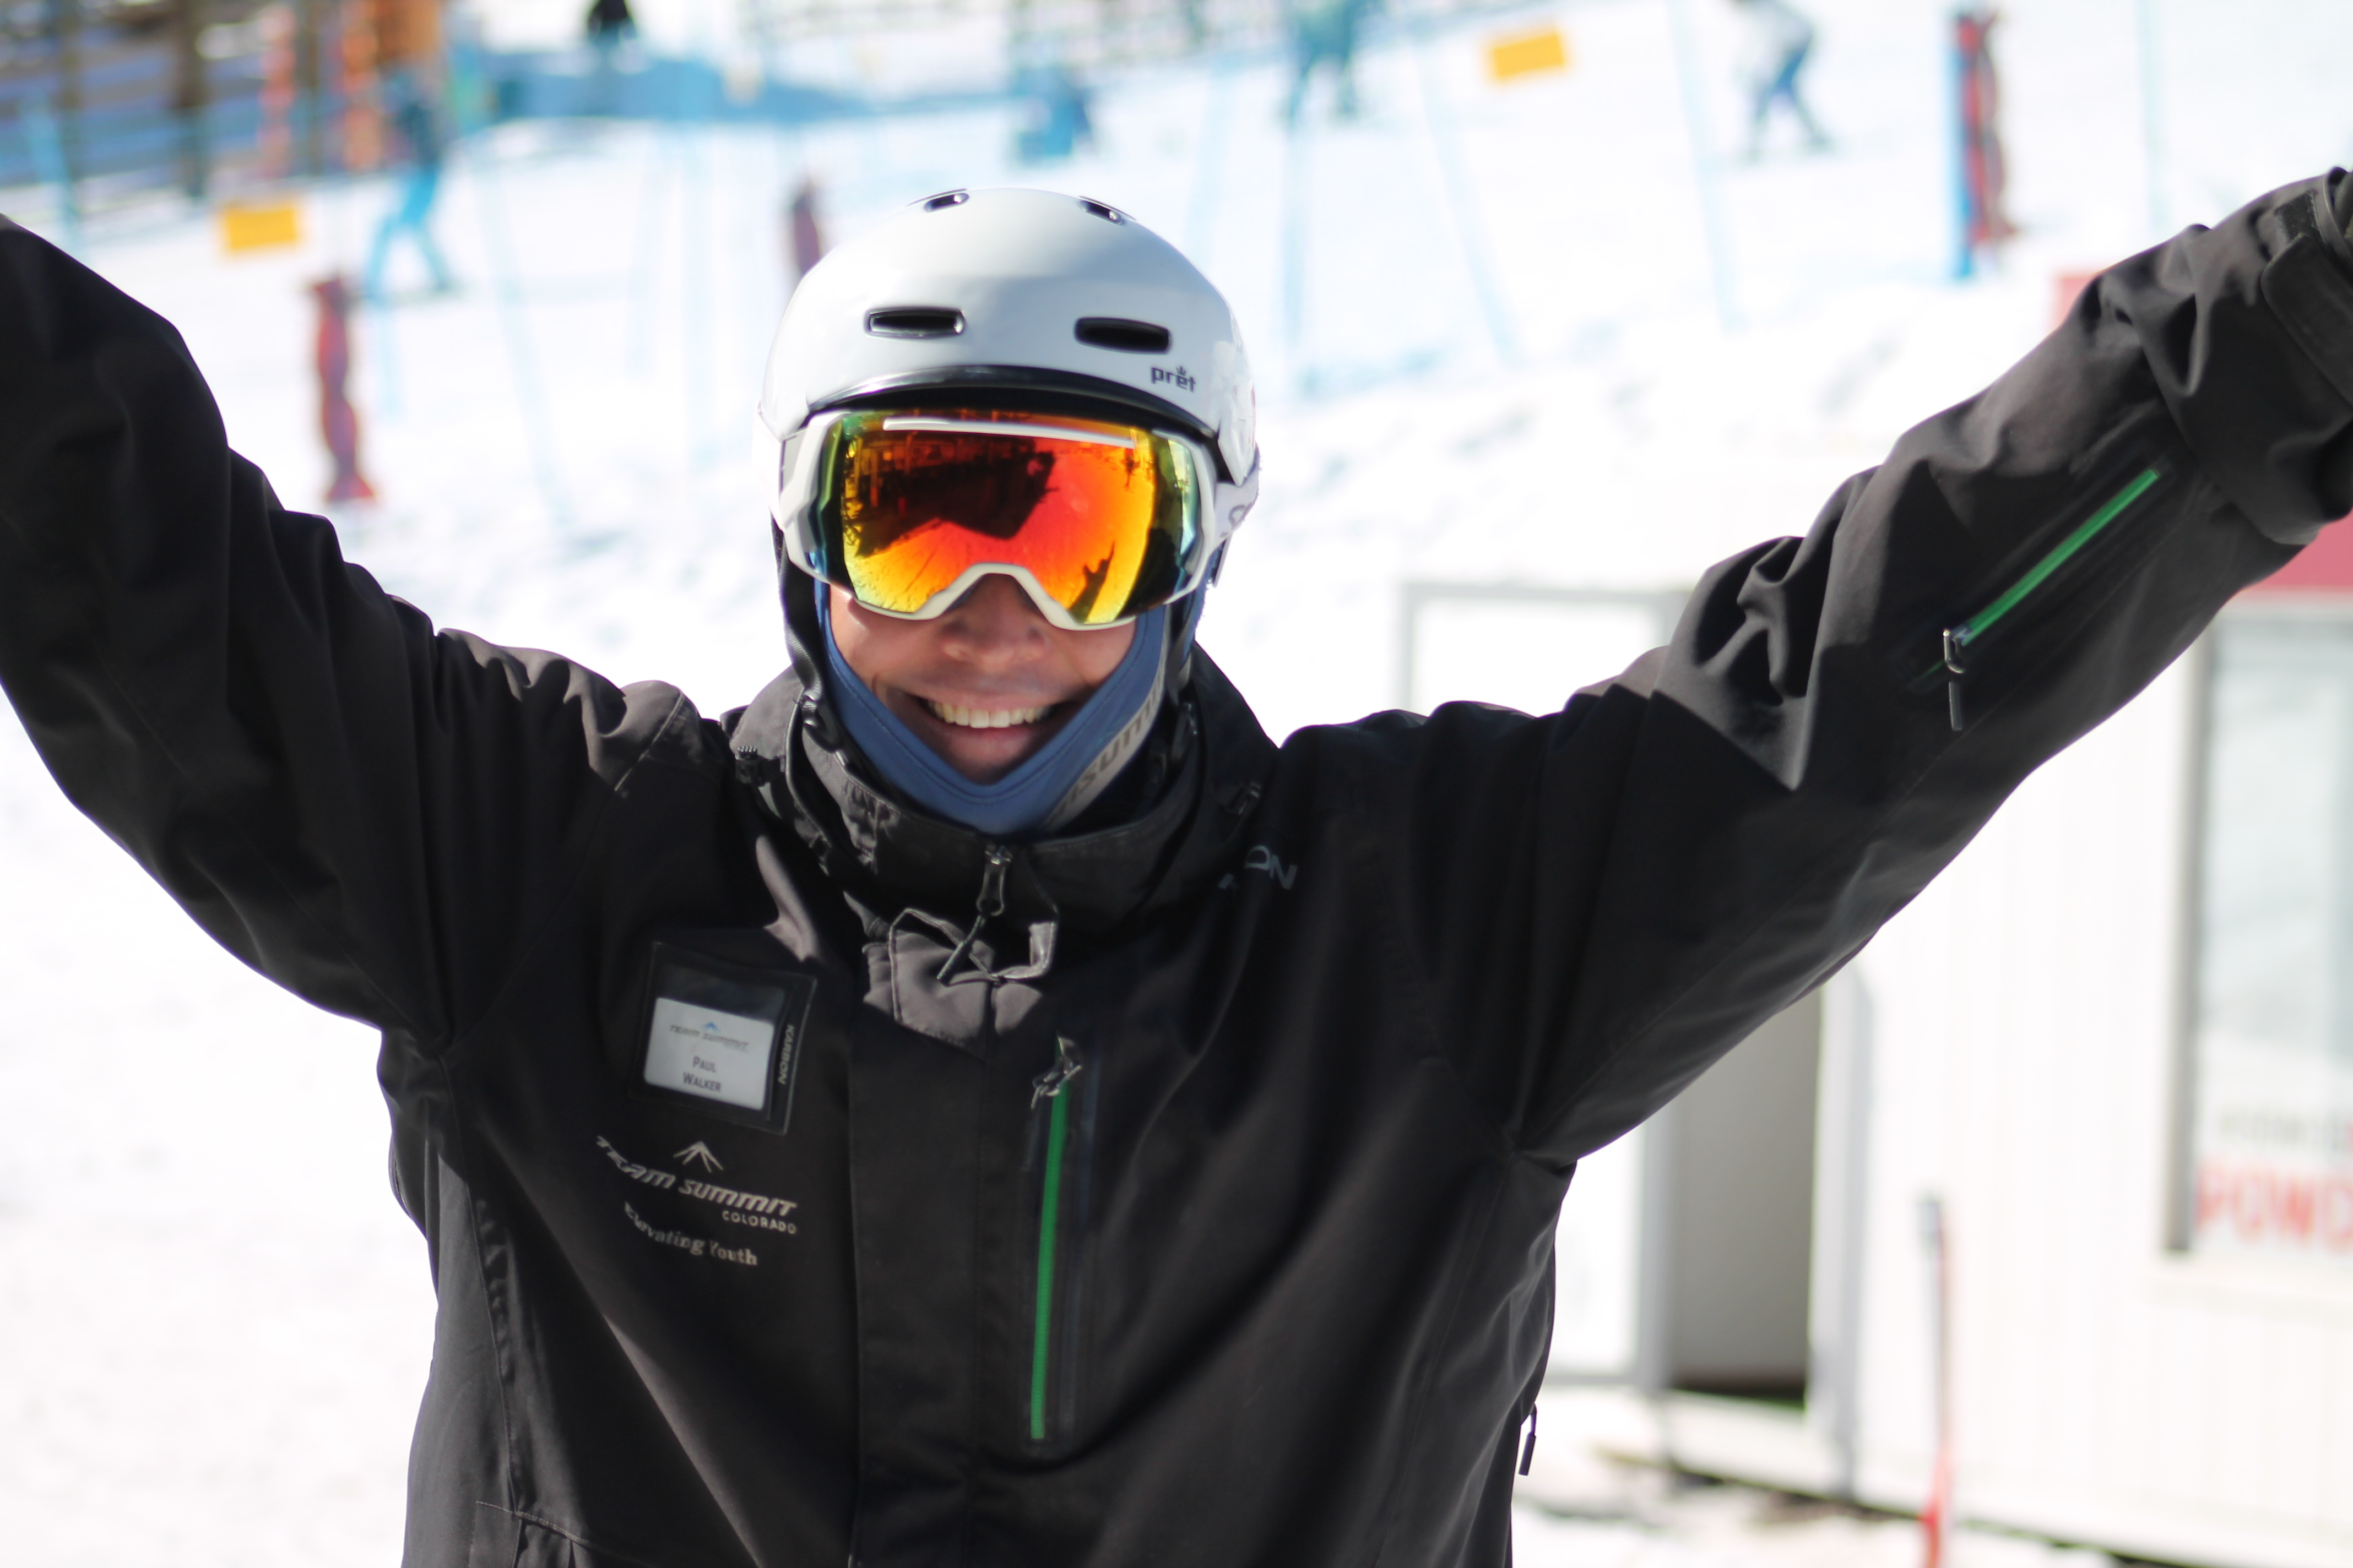
Manage the Group
Coaches Responsibilities
Keep it Safe
Make it Fun
Provide Proper Training
Listen and Be Aware
Educate Athletes and Parents
Communicate
Age and Terrain appropriate training
Communicate
Answer questions
Communicate
Have Fun Be Safe

Slide 12
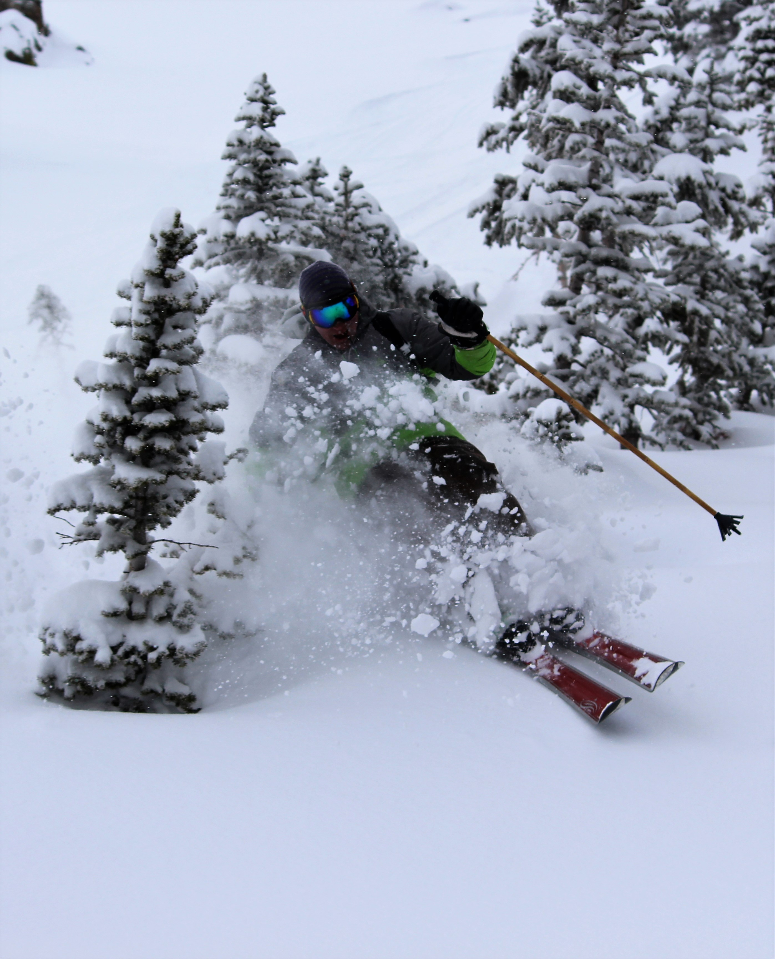
Support
Parent Responsibilities
“I Love Watching You Compete!”
Be on Time
Try to Notify coach if late or no-show
Have your Athlete Dressed Properly
Proper Nutrition
Trust the Coaches
Communicate with Coach and Staff
Cheer!
Drive
Cheer
Ask Questions
Check Calendars
Register for events
Sign up for off season training

Slide 13
Staff Education
Lvl 300 Mogul, Aerial, Freeski
Lvl 300 PSIA
Lv 200 USASA IFSA
Coaches Education- lvl Mogul 100 Project
Staff trainings throughout the season
Woodward training and usage
Level 200 Mogul Clinics
Spring training
H2o ramp training

Slide 14
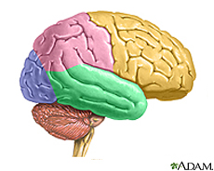
Manage Concussions
TBI/Concussion Info
Proper Helmet
“When in Doubt… Pull them Out”
Educate Athletes and Parents
Colorado State Law
Return to Sport Protocol
Limit Physical and
Cognitive Stress
Remove from Training/Comp
Follow -Up Care Very Important
Be Patient - 4 -6 weeks recovery is common
Understand the symptoms
Have Fun Be Safe

Slide 15
Safe Sport
Child Protection is Paramount
Mandatory Reporting
Sexual Misconduct Awareness Education
Emotional and Physical Misconduct

Slide 16
Trust your Training
Focus on daily goals
Track your training
Love what you are doing
Try your hardest
Maintain your line
“Success consists on going from failure to failure without loss of enthusiasm”
Winston Churchill

Slide 17
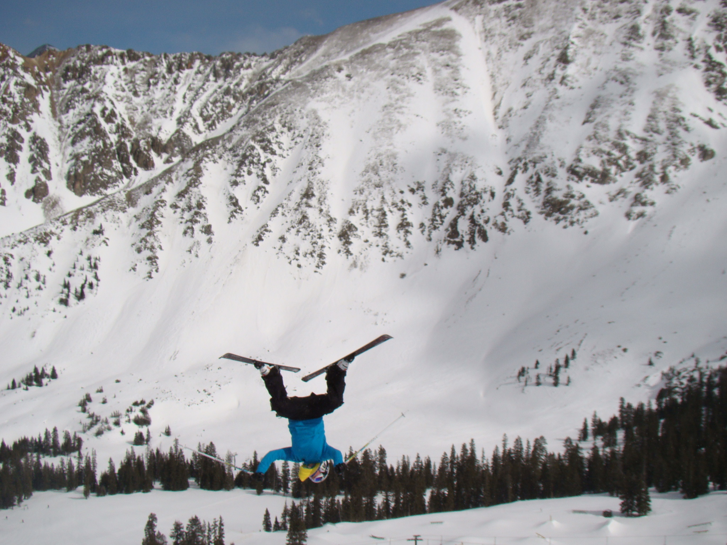
Support
Contact Info
Chris@teamsummit.org
970^389^2416
www.teamsummit.org
www.rockymountainfreestyle.com
www.rockymountainseries.com
www.ussa.org
www.freeskier.org
Questions???
Drive
Cheer
Ask Questions
Check Calendars
Register for events
Sign up for off season training

