Slide 1
TEAM SUMMIT FREESKI
Freeski Development
Big Mountain
Moguls
Park & Pipe
Academy

Slide 2
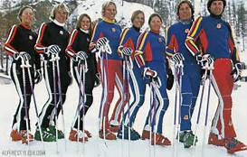
TSC Long History est 1970’s
Board of Directors
Sub committees
Executive Director
5 Program Directors
85 coaches
480 athletes (155 Freeski)
Chris’s 20th season
Landon’s 4th season

Slide 3
Mission We are a youth development organization empowering our athletes to realize and celebrate their personal podiums through athletics, education, and life skills by participating in innovative programming at our world class venues.

Slide 4
Core Values Excellence Respect Integrity Responsibility Fun Family Vision whole athlete | whole team | whole community

Slide 5
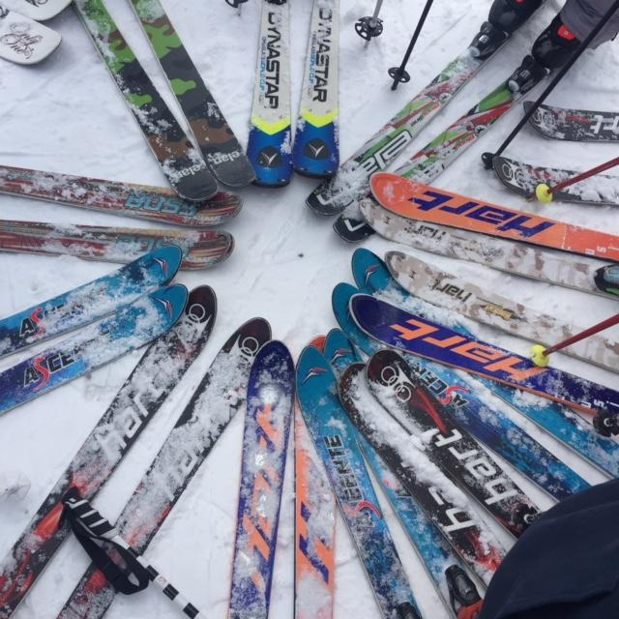
“Real Skiers Bus their own table”
Athlete Responsibilities
Respect Mountain Operations
Be Safe- Mandatory Comfort Bar
Listen to Coaches and Staff
Take Care of Equipment
Wear Your Team Summit Jacket with Pride
Be supportive of each other
Know the Code
Ask questions
Communicate
Have Fun Be Safe!

Slide 6
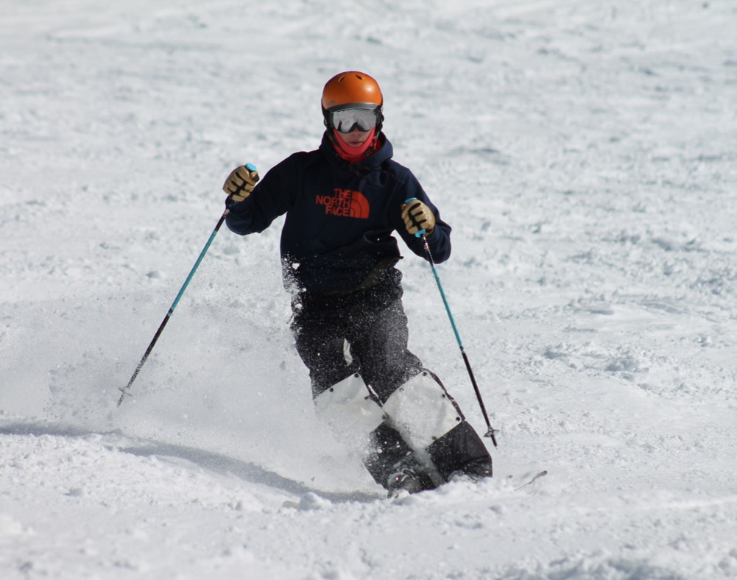
Skiing is an Individual Sport best practiced with a team
Athlete Responsibilities
Be on Time
Be properly Dressed
Sunscreen, face protection
Layers, hand warmers,
Be Rested and Ready
Stay Hydrated and fueled
Honest Effort
Team Spirit
Cheer each other on
Help each other out
Be positive
It Isn’t always easy

Slide 7
Trust your Training
Focus on daily goals
Track your training
Love what you are doing
Try your hardest
Maintain your line
“Success consists on going from failure to failure without loss of enthusiasm”
Winston Churchill

Slide 8
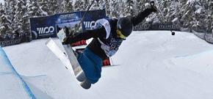
FS Devo Staff
Chris Carson - Freeski Director
Landon Ulrich - Freeski Development Head Coach
Land Le Coq - Copper Lead Coach
Scott Simpkins - Coach
Mallane Dressel - Coach
Alex Rus - Coach
Spencer McGaughey - Coach
Campbell Mckeogh - Coach/Social Media
Kyle Mashburn - Coach
Casey Donohoe - Coach

Slide 9
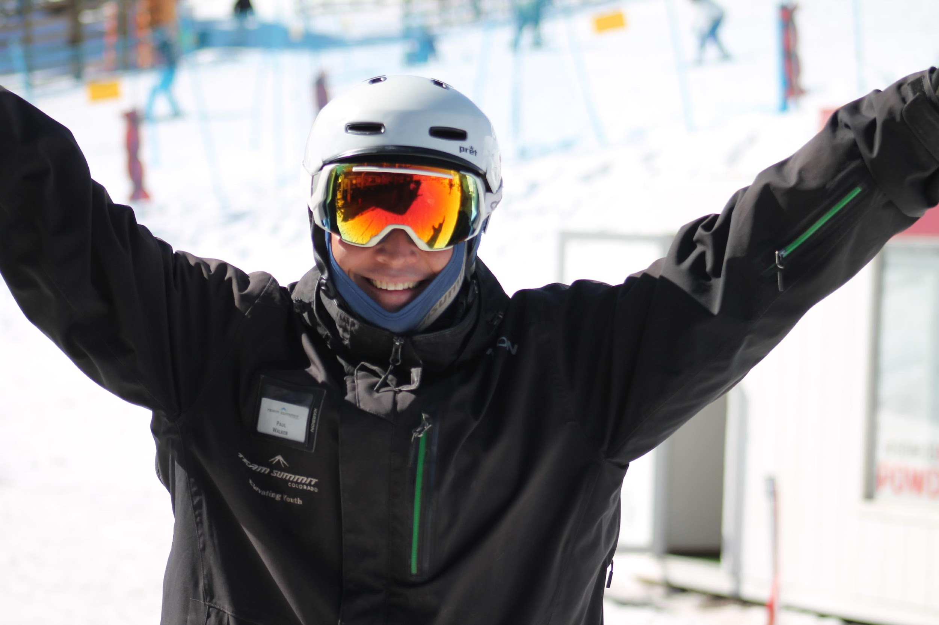
Manage the Group
Coaches Responsibilities
Keep it Safe
Make it Fun
Provide Proper Training
Listen and Be Aware
Educate Athletes and Parents
Communicate
Age and Terrain appropriate training
Communicate
Answer questions
Communicate
Have Fun Be Safe

Slide 10
Coaching Staff Education
Coaches Education- lvl 100 Mogul Project
Staff trainings throughout the season
Woodward training and usage
Level 200 Mogul Clinics
Spring training
H2o ramp training

Slide 11
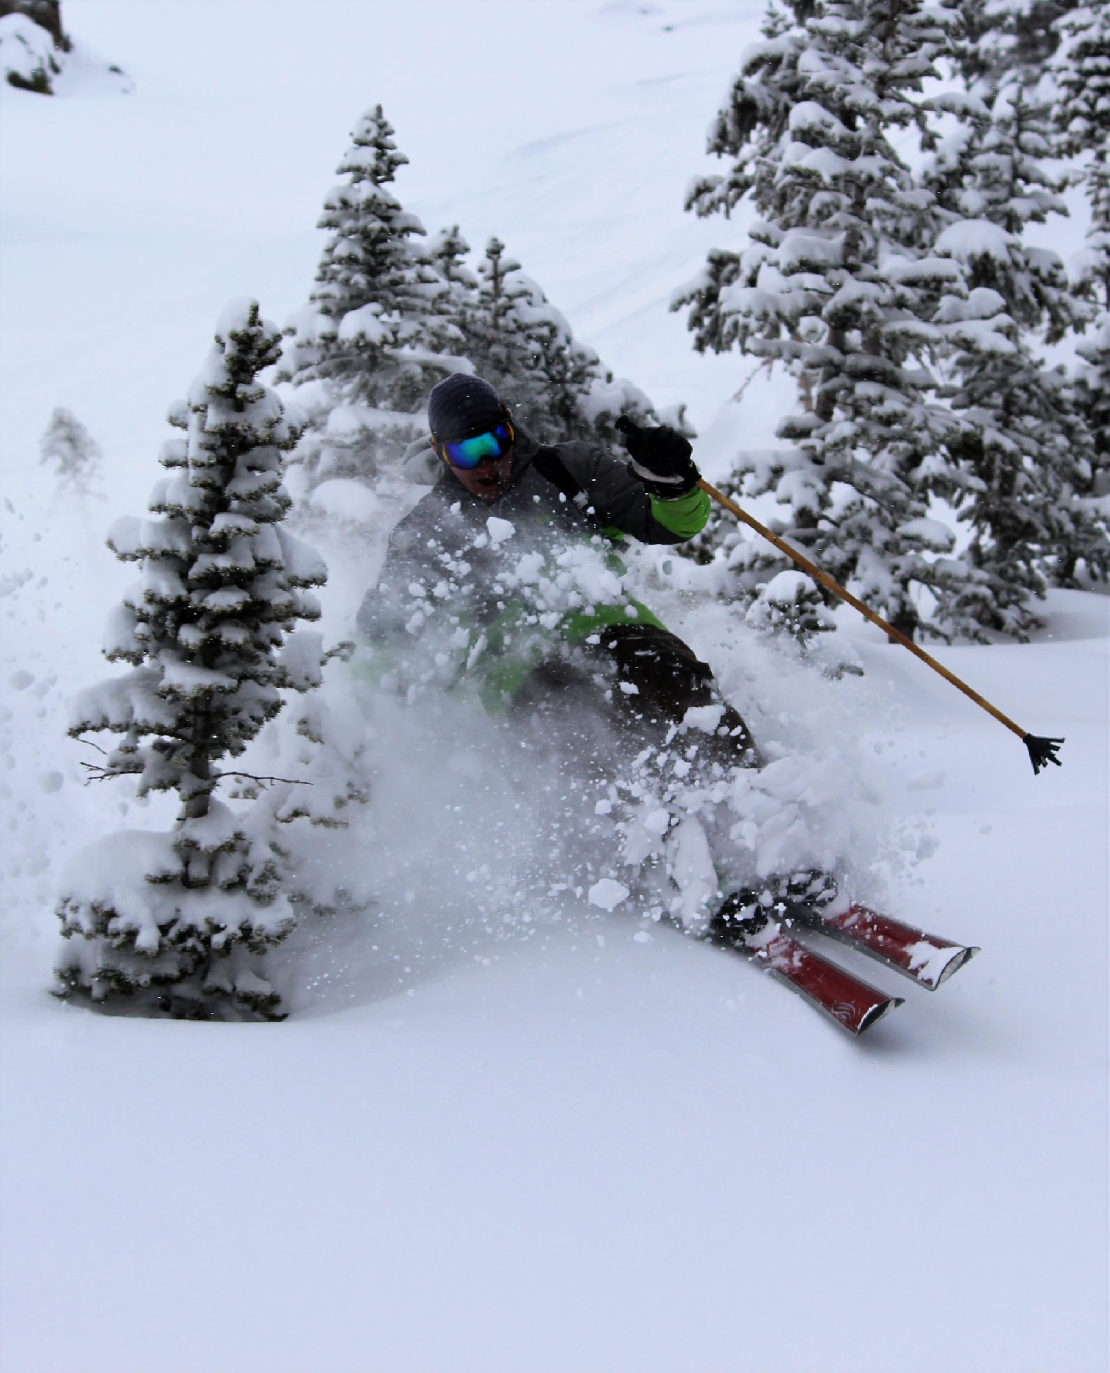
Support
Parent Responsibilities
“I Love Watching You Compete!”
Be on Time
Try to Notify coach if late or no-show
Have your Athlete Dressed Properly
Proper Nutrition
Trust the Coaches
Communicate with Coach and Staff
Cheer!
Drive
Cheer
Ask Questions
Check Calendars
Register for events
Sign up for off season training

Slide 12
Unique Training Venues
Copper
Arapahoe Basin
Keystone
Breckenridge
Snobahn
Frisco Adventure Park
Woodward
Team Trampolines

Slide 13
Mountain Meeting Locations

Slide 14
Calendar

Slide 15
Memberships/Competitions
USSA - Moguls (2-day membership vs full)
http://rockymountainfreestyle.com/
USASA - Park/Pipe/Skier X (single day membership vs full)
IFSA - Big Mountain (single day membership vs full)

Slide 16
Training Camp Opportunities
January 2-3 A-Basin Holiday Camp
April A-Basin Spring Camps
June 1 - August 31 Mountain Bike Program
June 14-17 UOP
June 16-27 Mount Hood (10 athletes max)
H20 Steamboat- ongoing
Aug 1 -5 UOP

Slide 17
TSC Athletic Trainer - Rachel Freeman (970) 296-4811
VSO Urgent Care - (970) 477-7419
360 Peak One Drive, Suite 180, Frisco, CO 80443
For Concussion, call (970) 477-7419

Slide 18
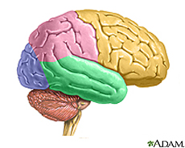
Manage Concussions
TBI/Concussion Info
Proper Helmet
“When in Doubt… Pull them Out”
Educate Athletes and Parents
Colorado State Law
Return to Sport Protocol
Limit Physical and
Cognitive Stress
Remove from Training/Comp
Follow -Up Care Very Important
Be Patient - 4 -6 weeks recovery is common
Understand the symptoms
Have Fun Be Safe

Slide 19
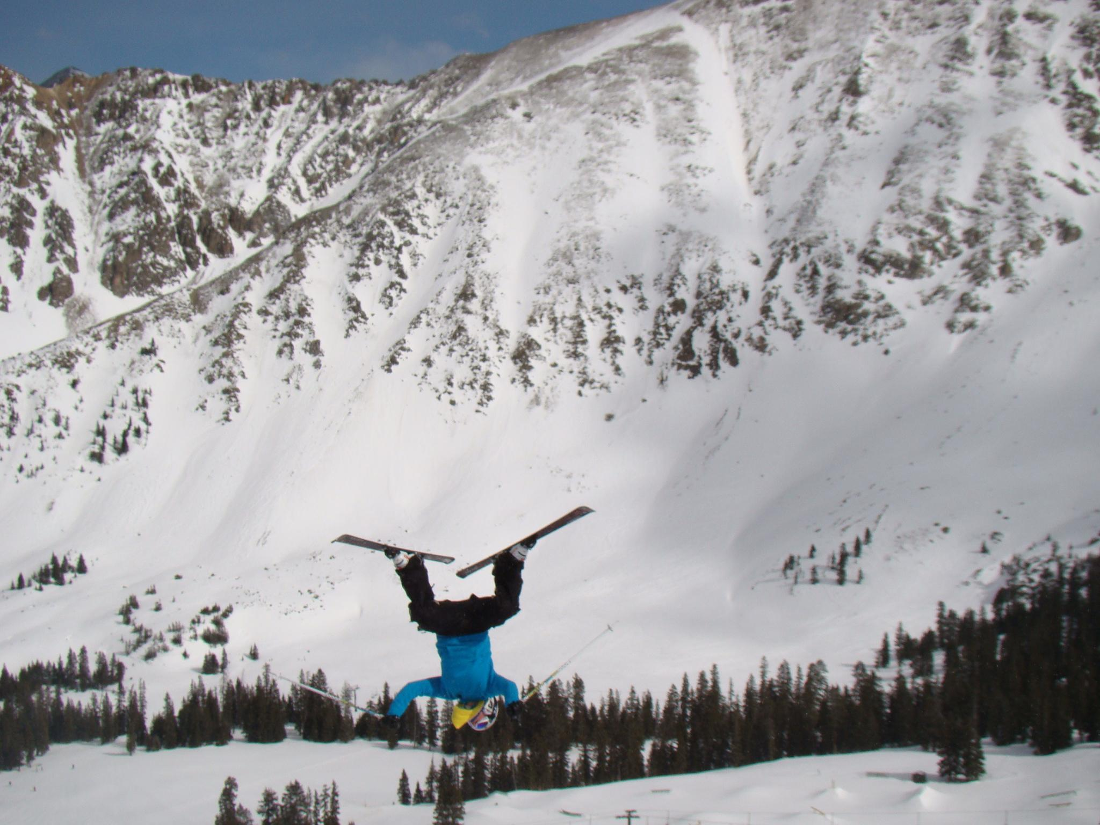
Contact Info
landon@teamsummit.org
865-696-5445
chris@teamsummit.org
970-389-2416
www.teamsummit.org
www.rockymountainfreestyle.com
www.ussa.org
www.freeskier.org
Questions???

