Slide 1
Team Summit Colorado
An Intro to Team Summit
Whole Athlete, Whole Team, Whole Community

Slide 2
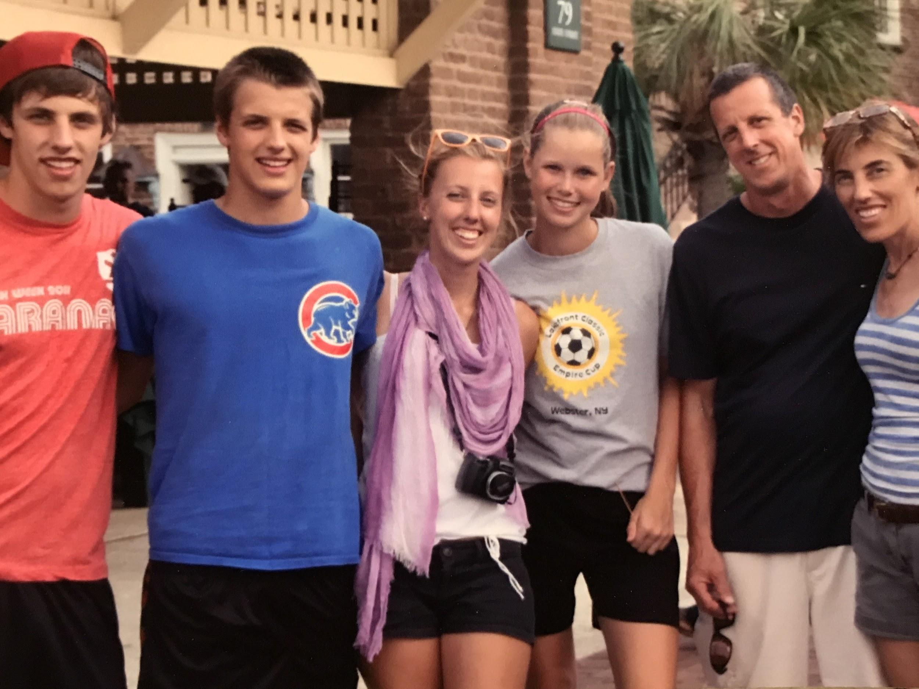
https://teamsummit.org/leadership-1/board-and-staff
Theresa Eckert
Intro to Team Summit
Head Coach

Slide 3
Core Values
Excellence: Elevating youth by delivering innovative programs at world-class venues
Respect: Elevating youth by promoting values in a culture of teamwork and dedication
Integrity: Elevating youth by fostering character and honesty
Responsibility: Elevating youth by instilling self-confidence, wellness, and educational accountability
Fun: Elevating youth through an engaging interactive lifestyle
Family: Elevating youth by teaching life skills, embracing community, and honoring culture

Slide 4
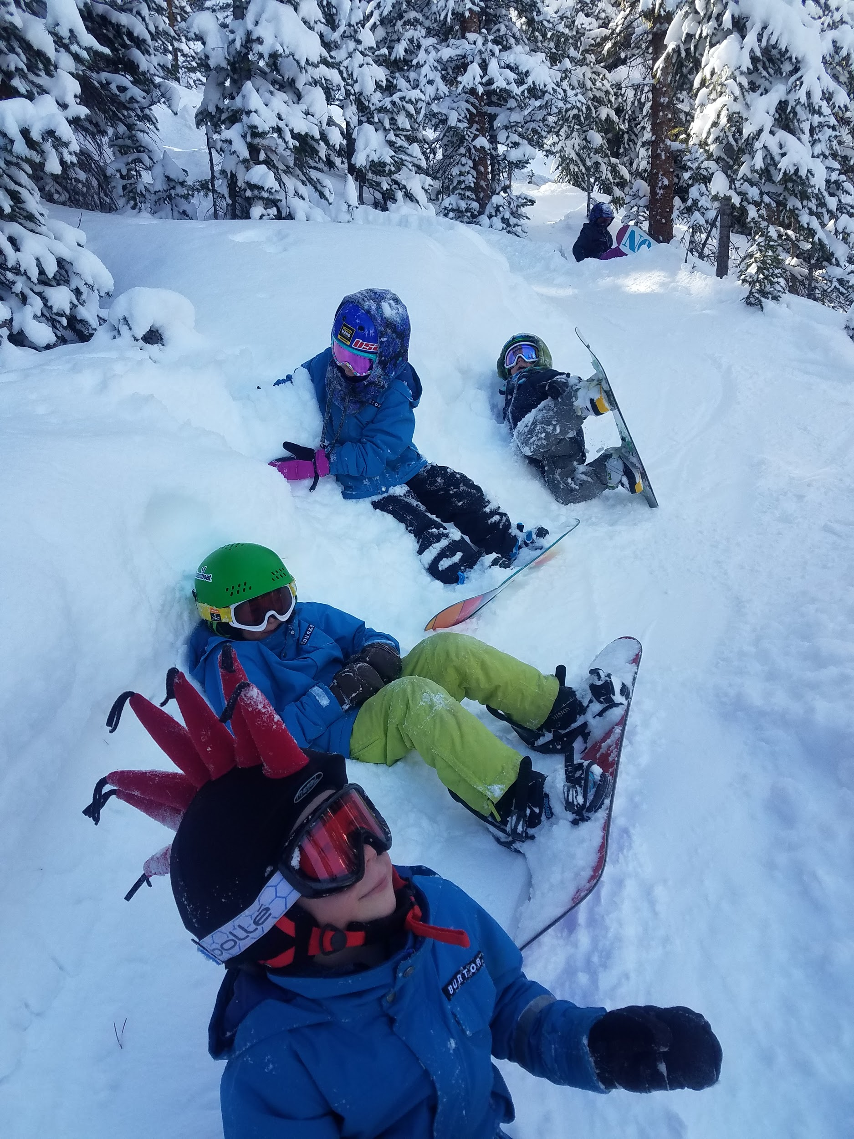
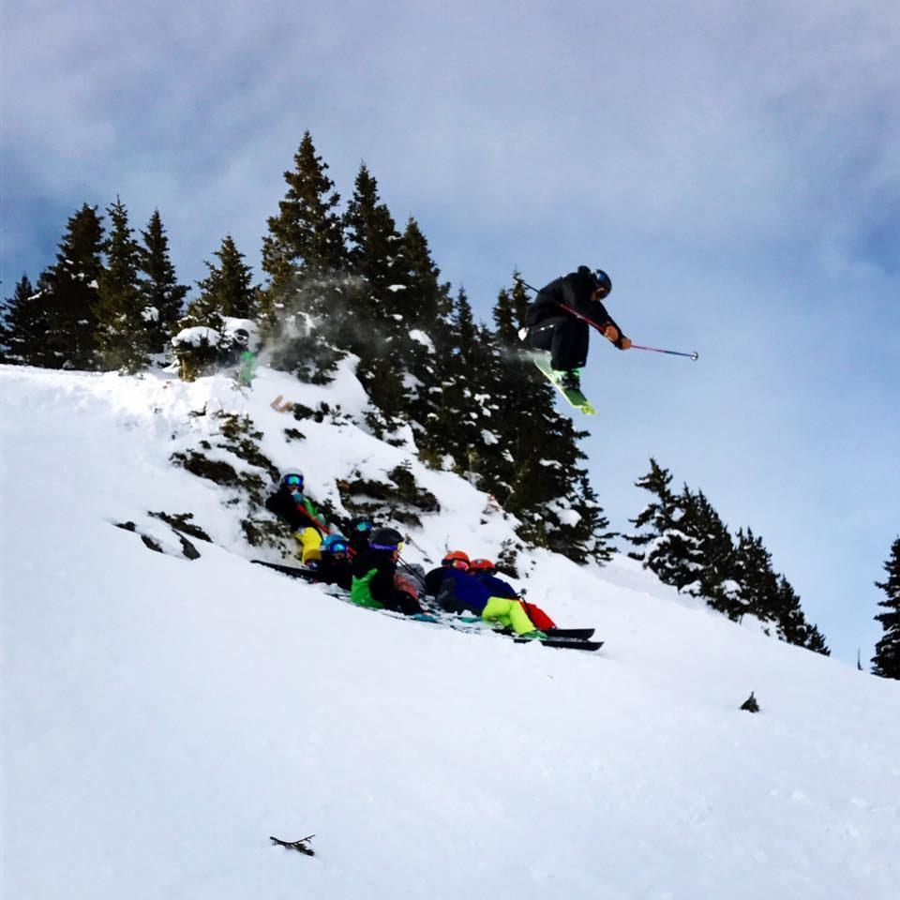
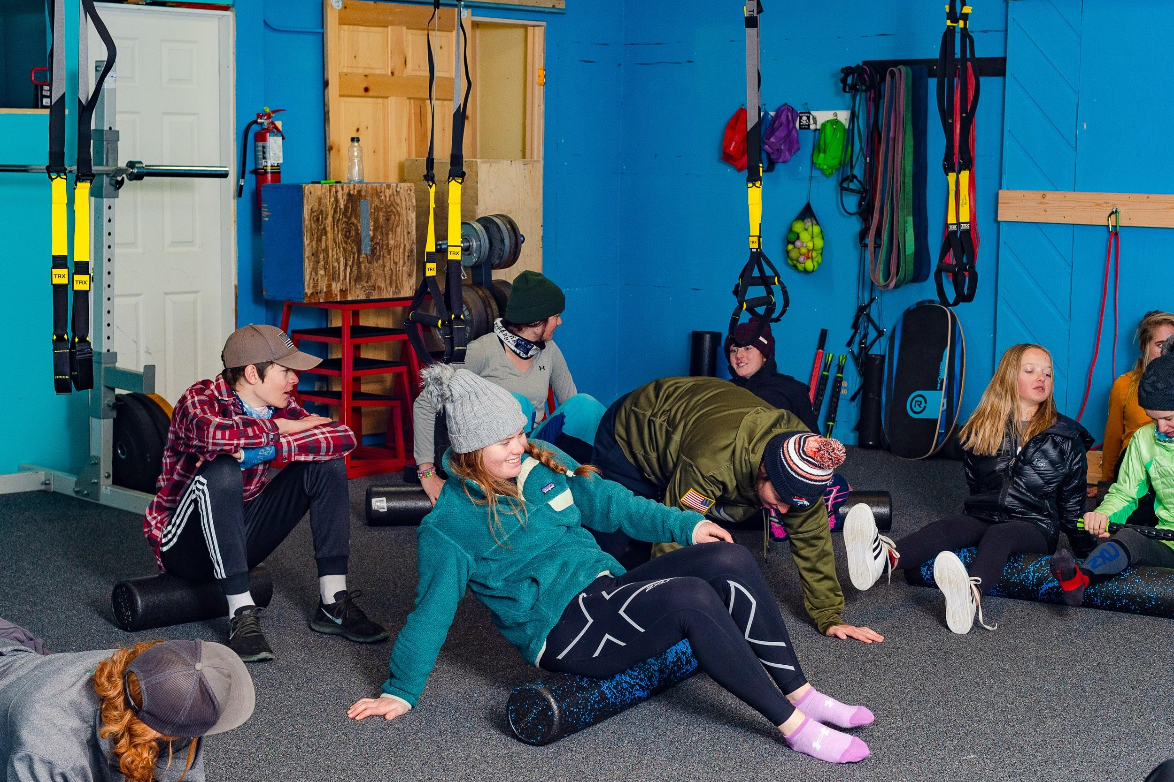
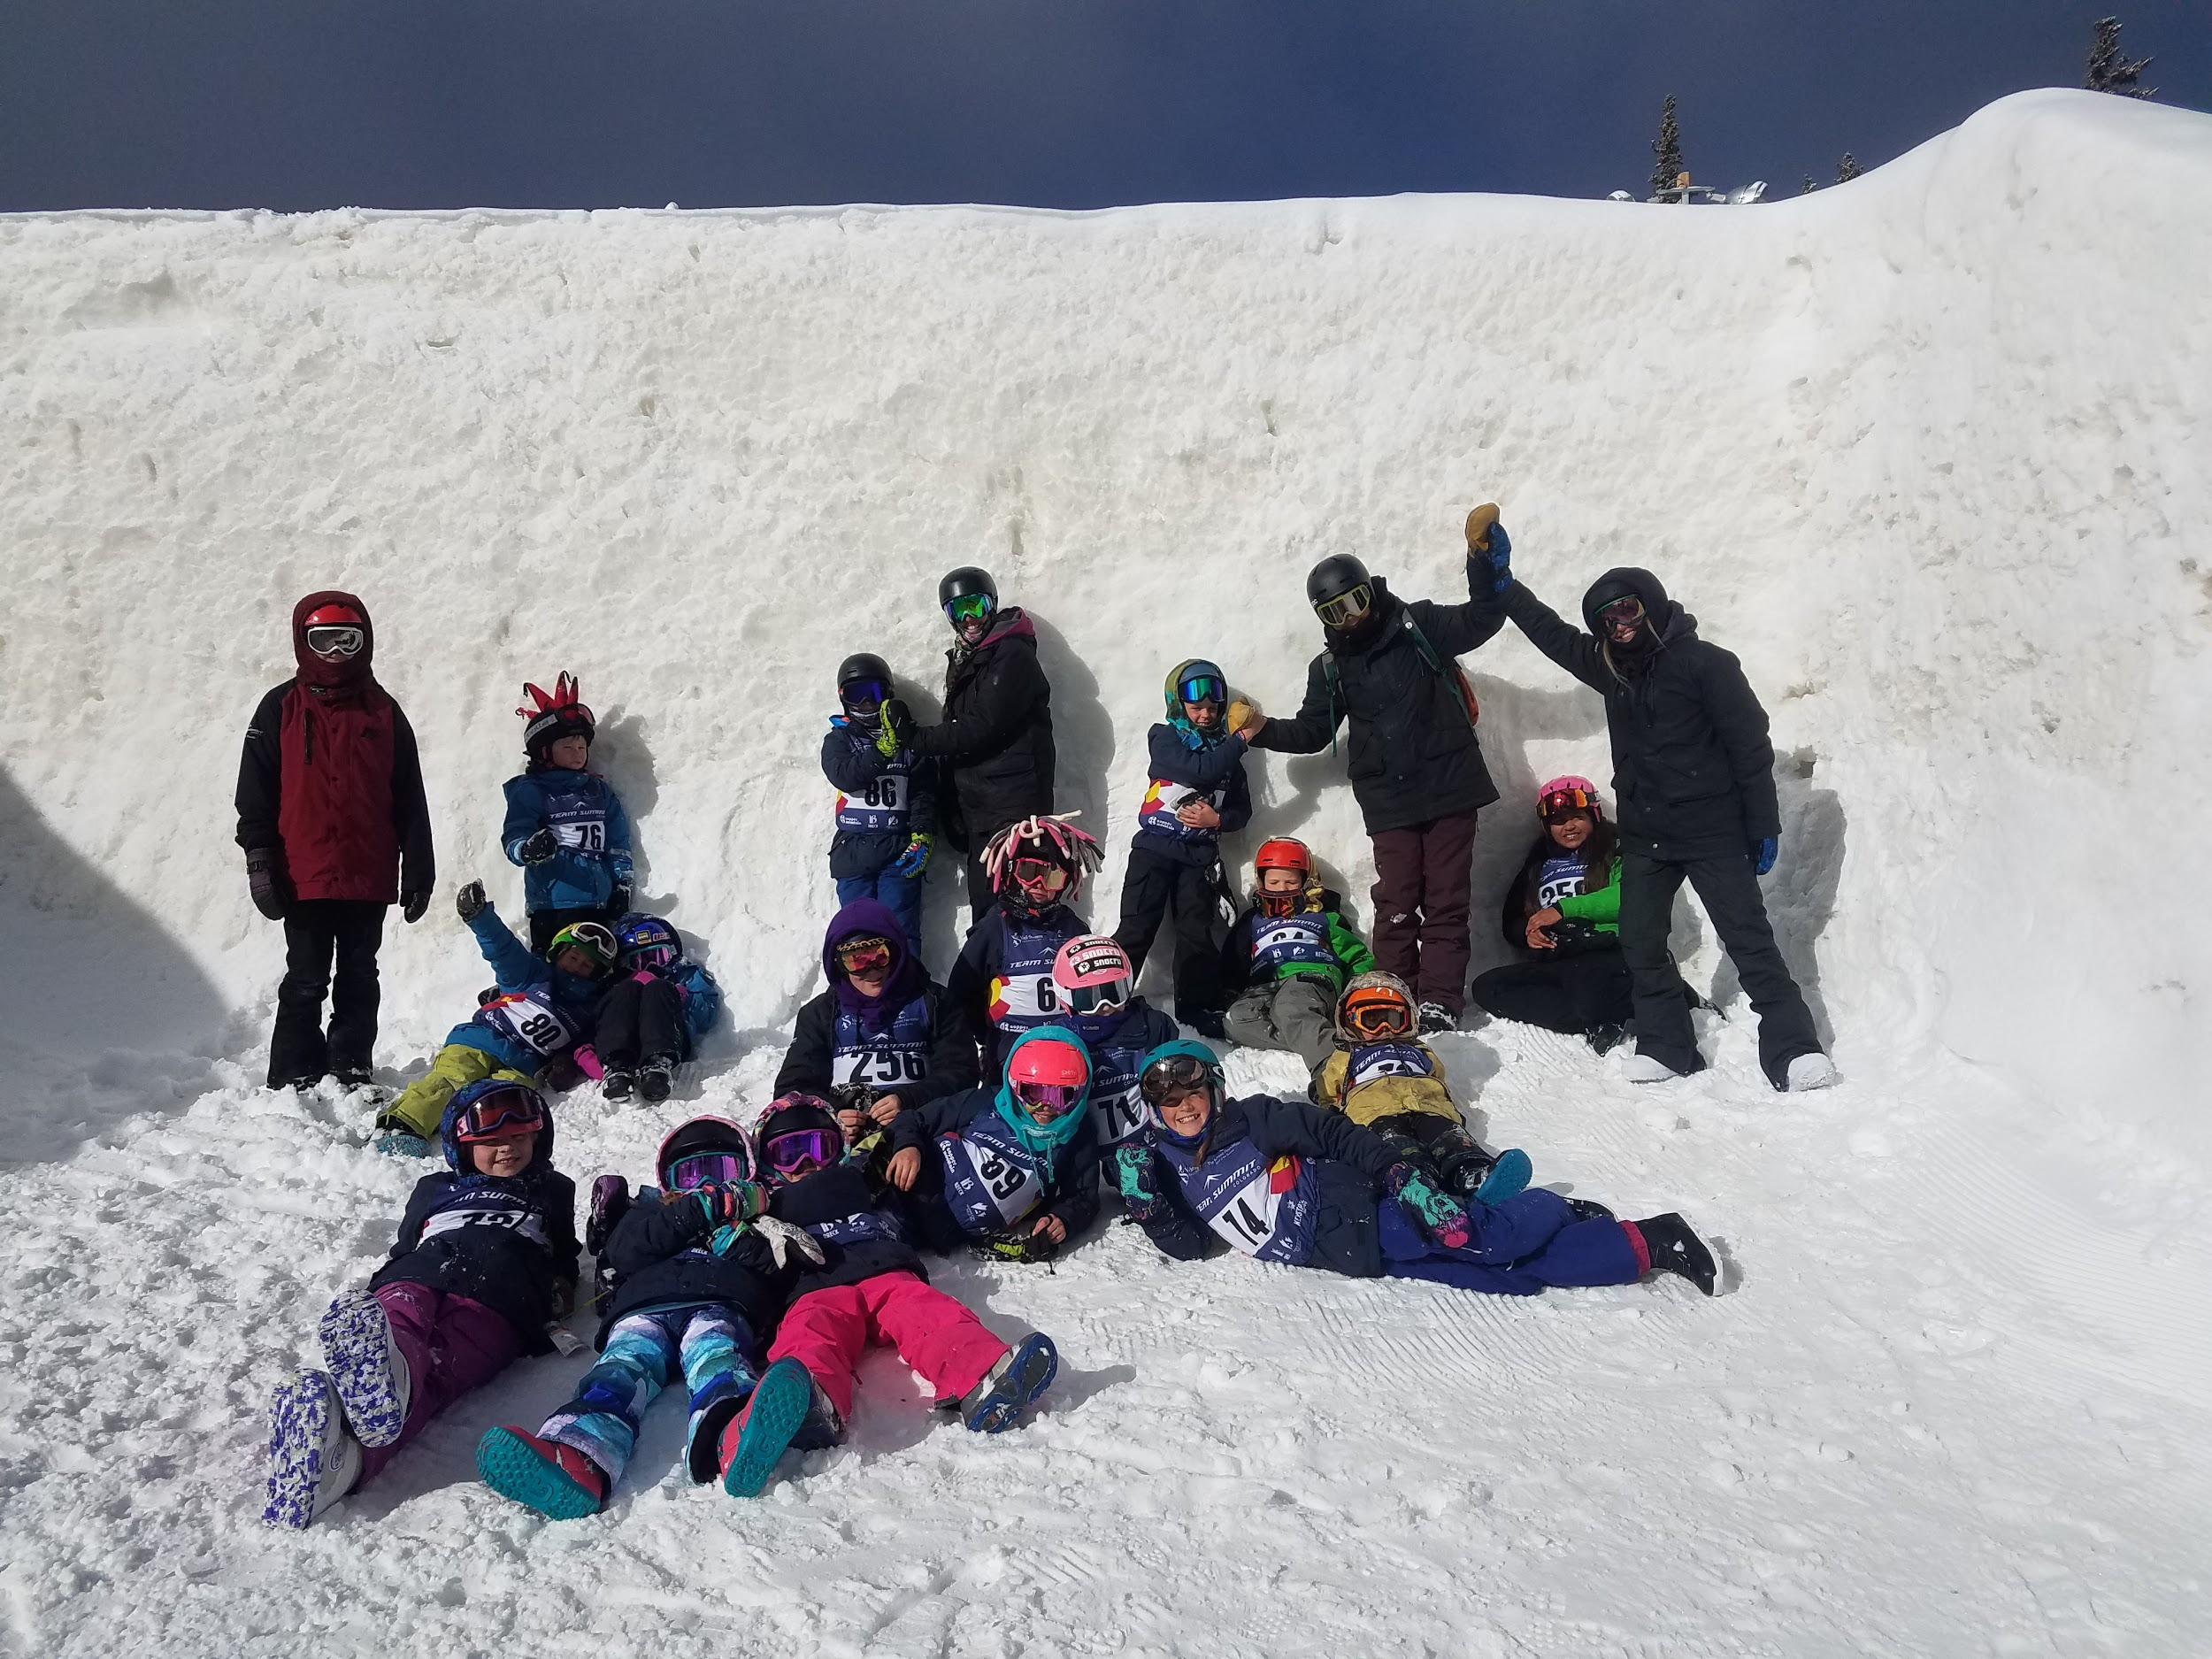
Fun is the essence of play, and it constitutes the core of successful youth sport experiences.

Slide 5
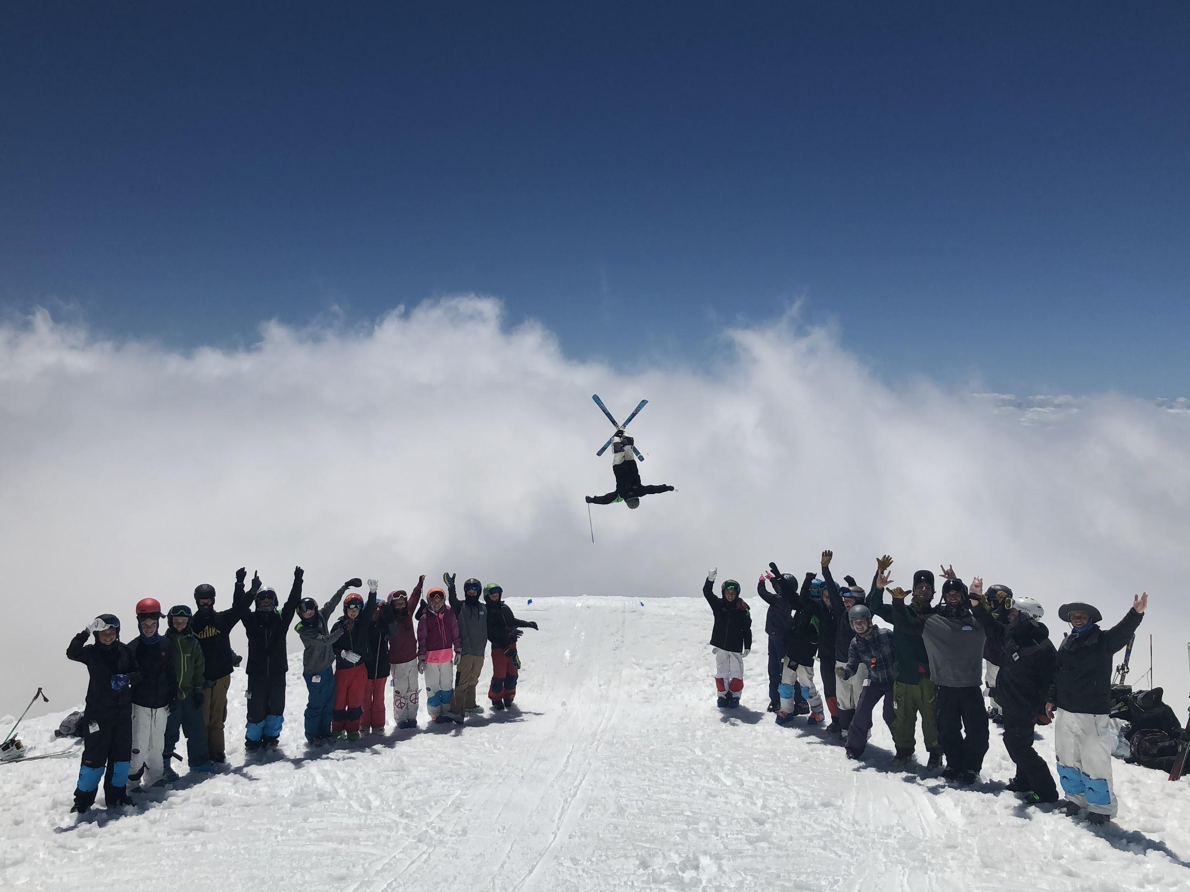
Intro to Team Summit (ITS) Goal
To elevate athletes so they have the opportunity to flourish in life skills and achieve their personal podiums.
Team Summit is proud to have nurtured athletes who have competed in World Championships, the X Games, and the Olympic Games.
Are you ready for your student athlete to experience world-class training, develop life long friendships, and develop the pride that comes with being able to conquer any part of the mountain?

Slide 6
Goals for ITS
Fun!
Learn Basic Skiing and Snowboarding Fundamentals
Stance and Balance
Rotary Skills
Pressuring Skills
Edging Skills
Learn Basic Alpine Racing Fundamentals
Equipment
Technical and Tactical
Mental and Social
Competition
Follow USSA LTAD and ATS System utilizing SkillsQuest

Slide 7
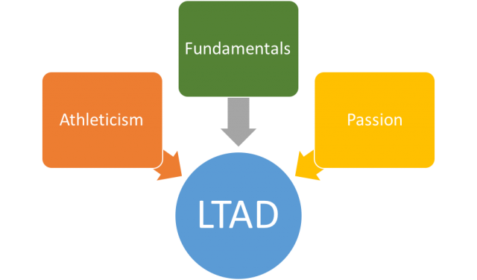
Long Term Athlete Development(LTAD)

Slide 8
Fundamentals: a focus on building basic skills in all areas of the sport that will lead to high performance of more specialized skills over time.
Athleticism: the application of fundamental skills through a multitude of environments and sports focusing on building higher capacity in all elements of physical fitness and health.
Passion: the fuel drives athletes to pursue the sport with joy, grit, and perseverance sustaining a lifetime of constant improvement and enjoyment.

Slide 9
Alpine Training Systems Matrix(ATS)
Each sport's training system is based on a document called the training system matrix. The matrix contains the fundamental information to direct sport participation, conditioning, technique and tactics, equipment selection and maintenance, performance psychology and competition in each sport. In one page, parents, athletes, coaches, and clubs can see how programming builds through the phases to lead to an individual's full potential.

Slide 11
SkillsQuest
SkillsQuest is a cornerstone program of the U.S. Ski & Snowboard Training Systems and designed to motivate and reward athletes in working toward and improving abilities in the key areas of emphasis. As its name implies, it represents a quest, or journey, toward success in competitive skiing and snowboarding, by focusing on skills, the critical components that make up a high-performing athlete. It includes activities and competencies for skiing skills, technique, and tactics, conditioning, equipment preparation, performance psychology and athlete management.

Slide 14
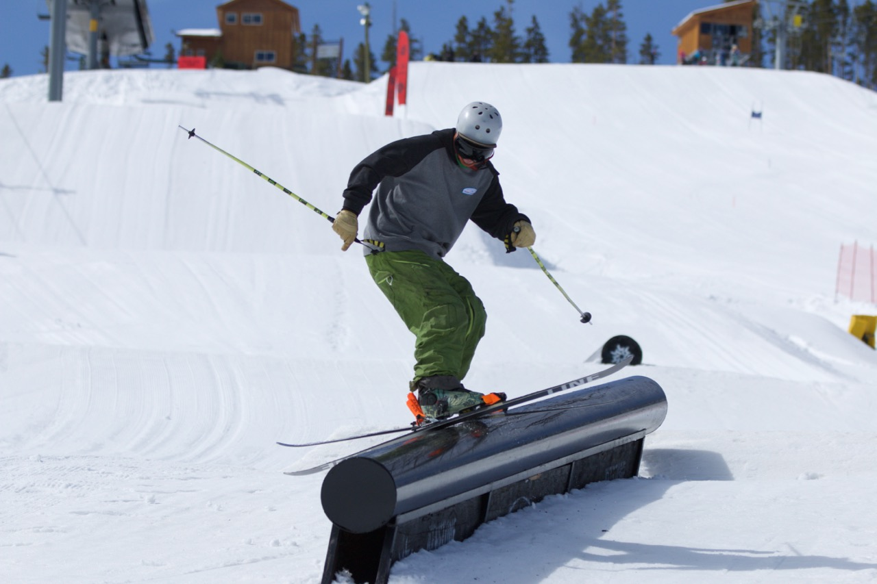
Equipment
Skiers
Properly tuned Skis w/ bindings (ski length between chin and forehead). Boots need to properly fit the athlete! Boots that are too big make it difficult for the athlete to control the ski and make fluid turns. 3-4 Buckle boot is a necessity.
Poles (for skiers) should fit properly. To ensure a proper size, have your athlete flip the pole upside down and hold the pole below the basket. Their arms should be at a 90 degree angle.

Slide 15
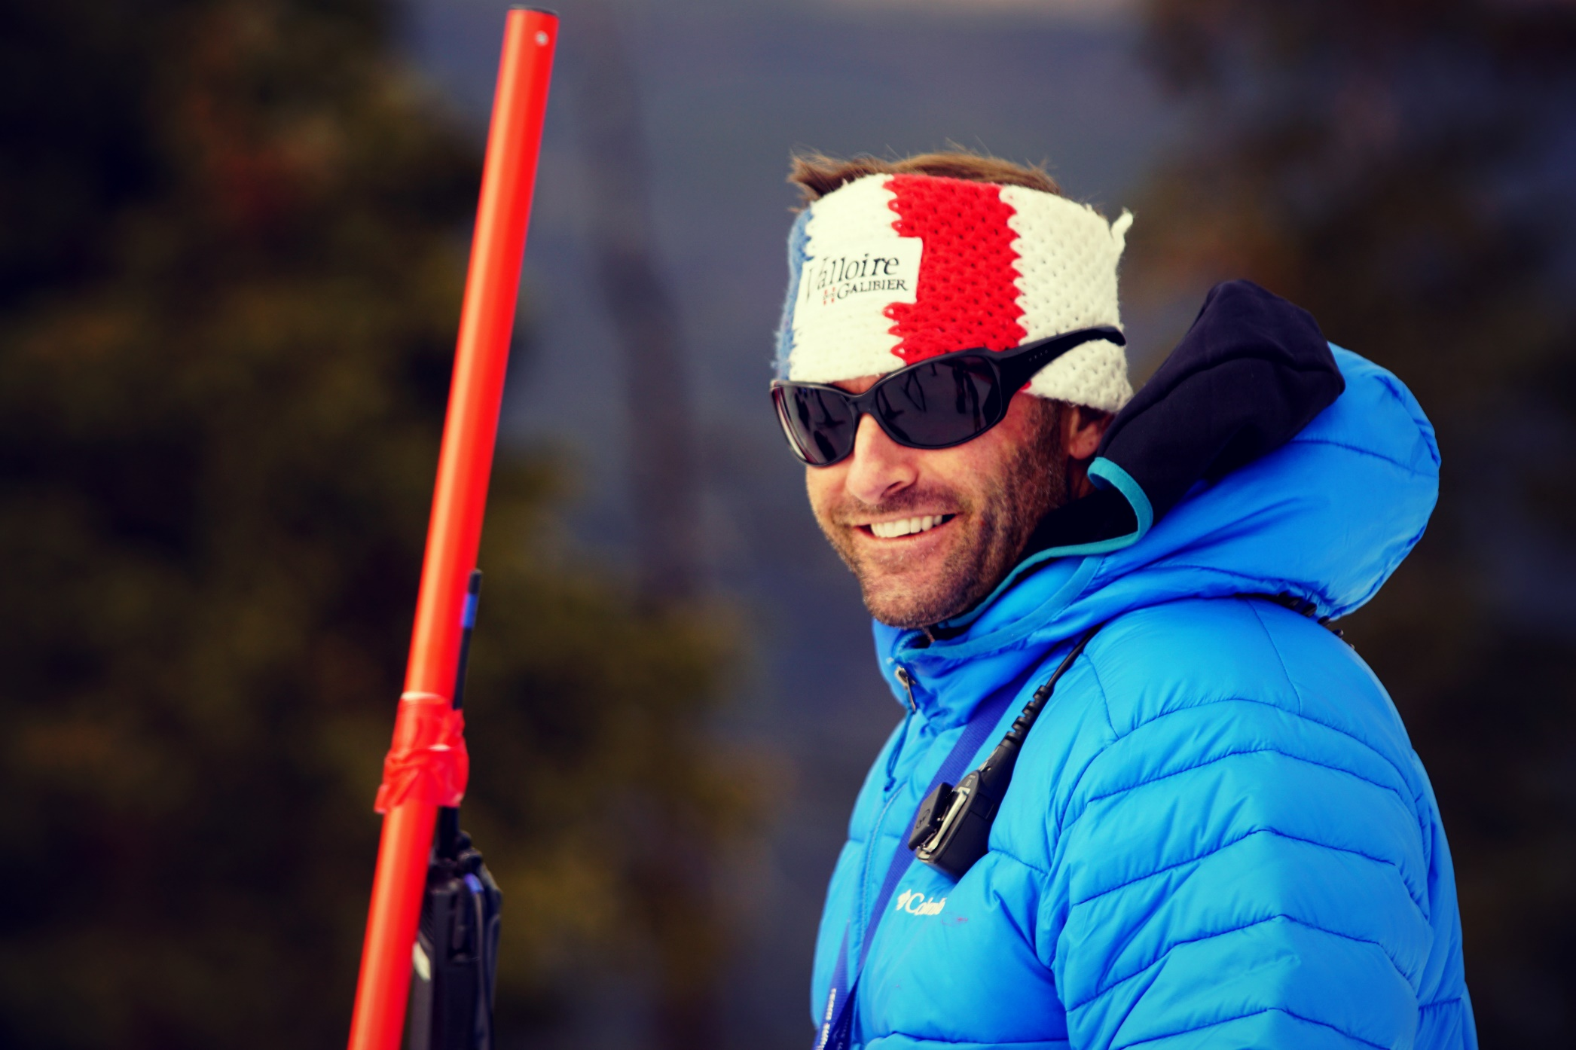
Managing the Group
Coach Responsibilities
Keep it safe, facilitate fun
Provide Proper Training
Teach the latest tactics & technique
Provide a Supportive Environment
Listen and Be Aware
Educate Athletes and Parents
Be a great Communicator
Timely and relevant video feedback
Age appropriate training
Answer questions
Communicate
Have Fun Be Safe

Slide 16
Mountain Safety Coaching
All TSC athletes and coaches are required to utilize the comfort bar for all the chairlifts at all resorts.
Safety talks
Skiing in-bounds
Slow signs
Loading the chairlift with backpacks

Slide 17
Coach > Parent Communication
Weekly Emails
Evaluations
Training Feedback/concerns
In person at least once every two weeks

Slide 18
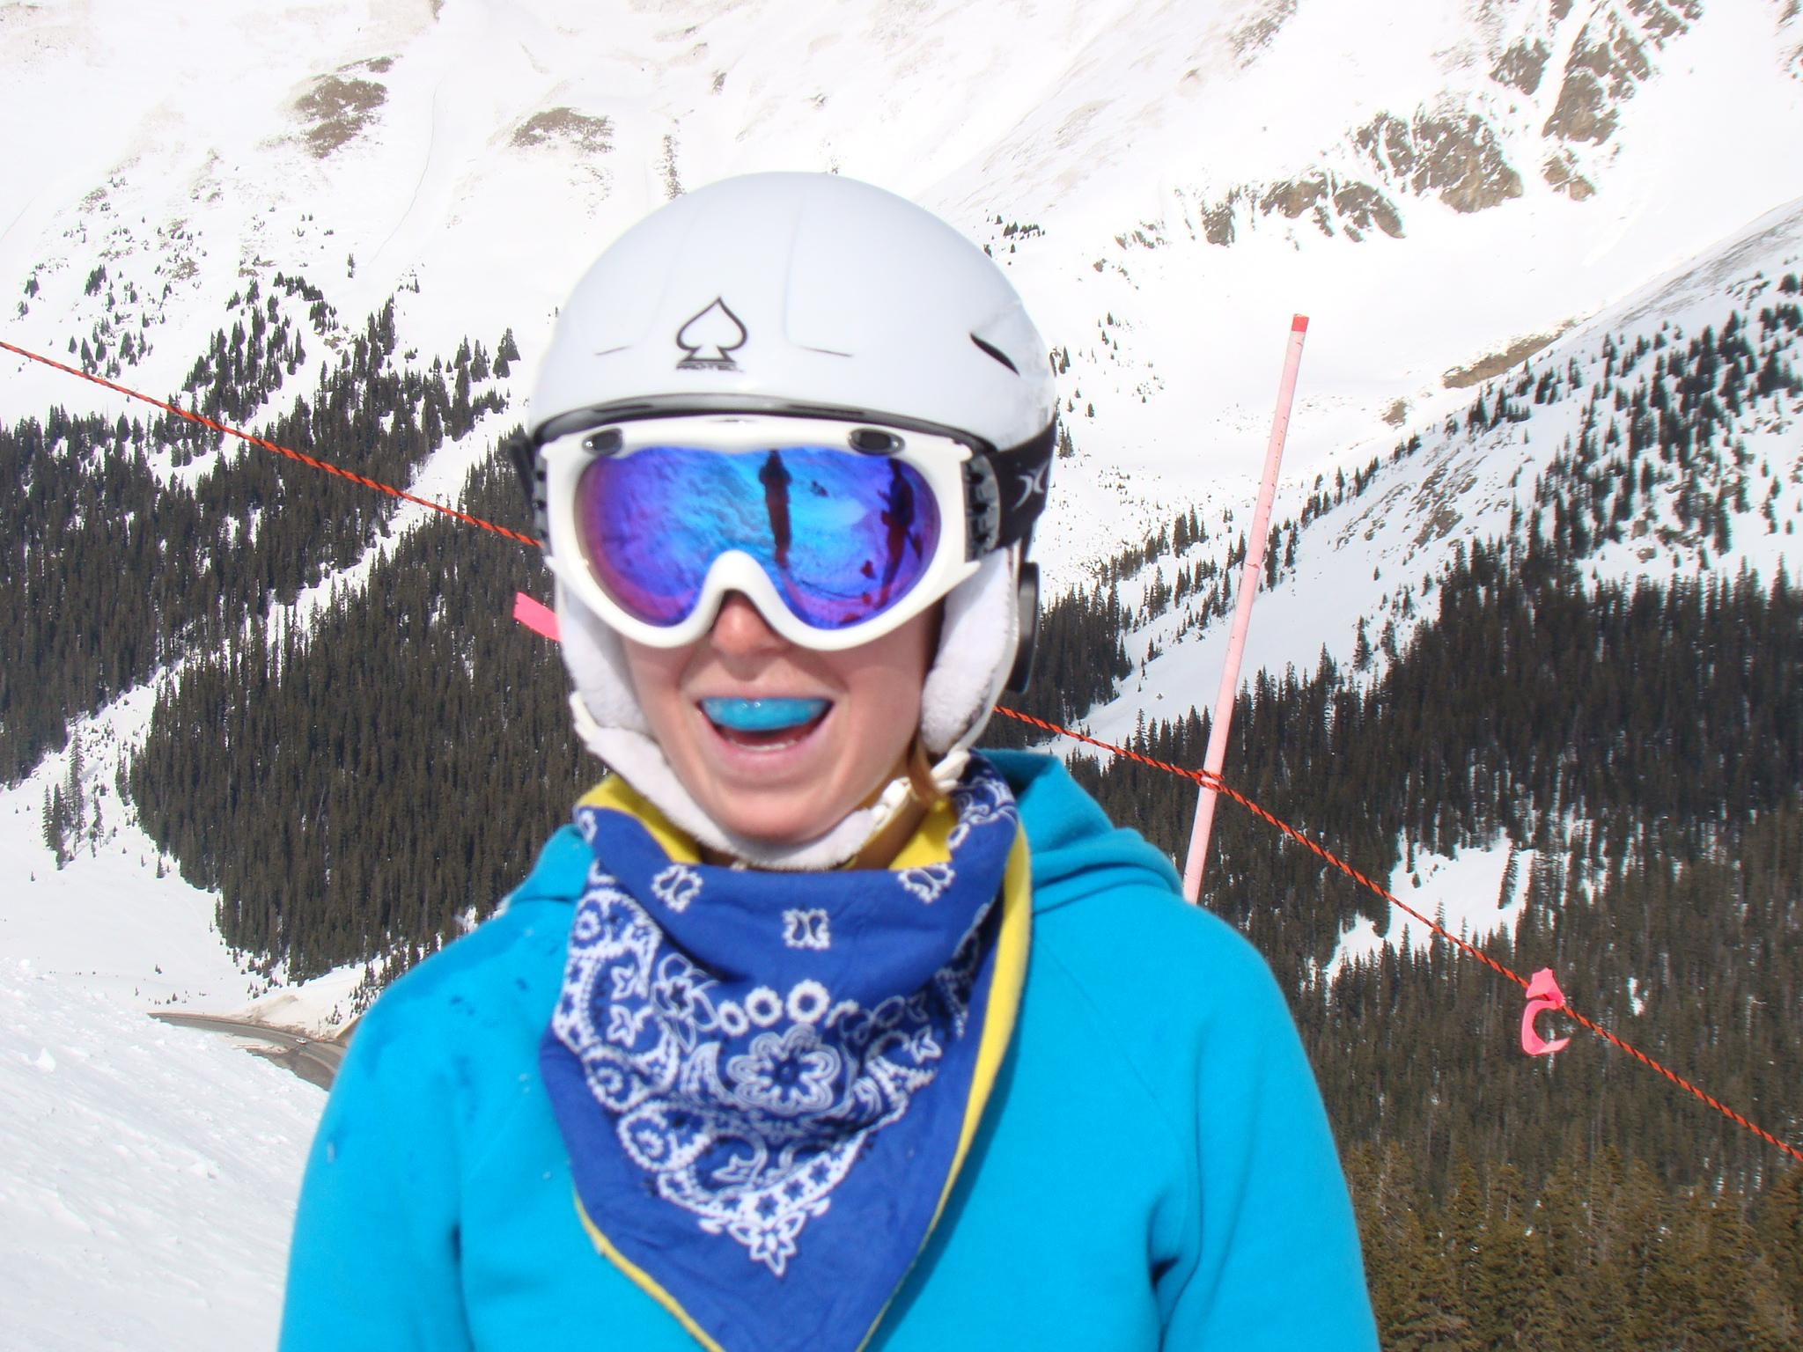
Skiing is an Individual Sport best practiced with a team
Athlete Responsibilities
Be Safe
Know the Skier Responsibility Code
Be on Time
Be properly Dressed
Sunscreen, face protection
Layers, hand warmers,
Be Rested and Ready
Stay Hydrated and fueled
Be prepared for Lunch

Slide 19
Athlete Responsibilities
Respect
the Resort and the Guests
Be Responsible
“Real athletes bus their own table”
Take care of equipment
Rack skis properly
Team spirit is vital: cheer for each other
and
help each other out!
Wear your Team Summit Jacket with Pride
High Visibility
Sponsor Expectations
Be courteous and polite
Ask questions, have fun and be safe

Slide 20
What should Parents Do?
Volunteer
Expect Chaos
Depend on and trust coaching staff
Keep it Fun!
Support the dreams of your our athlete
Cheer on your athlete and show positive reinforcement
Ask your child if they had fun
Ask them what they thought they did well and what they could do better
Tell your athlete how proud you are of them
Show positive reinforcement
Be early! (If you’re early, you’re on time; if you’re on time, you’re late; and if you’re late you’ve missed the lift!)

Slide 21
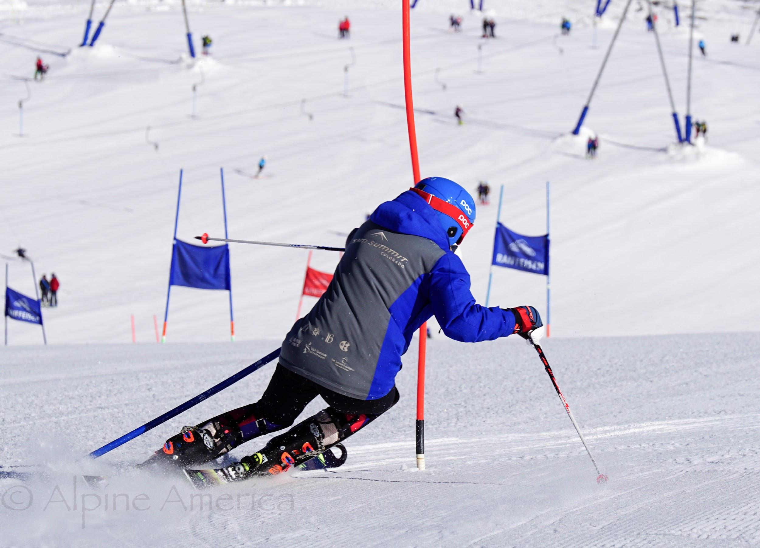
Parenting successful skiers
You are part of the team!

Slide 22
Typical Day of Training
8:00 a.m. Arrival at ski area (Breck- 8:30)
8:10 a.m. Breakfast/Snack, water, restroom break
8:15 a.m. Gear Up for AM training (boots, gloves, facemask, helmet/goggles)
8:25 a.m. Head out to snow for coach greeting
8:30 a.m. Get in line for lift
8:45 a.m. Warm-up lap/Group stretch/Warm-up lap
9:00 a.m. First Morning Training: Introduction of skill for the day and explanation of relation
10:05 a.m. Snack, water, restroom break
10:15 a.m. 2nd a.m. Training: Execution of skill for the day
12:00 p.m. Lunch, water, restroom break
12:30 p.m. Gear up for p.m. training
12:45 p.m. Stretch/morning recap
12:55 p.m. Get in line for lift
1:05 p.m. Training: Skill for the day and its incorporation to freeskiing (aka skiing with no agenda…just having fun)
2:15 p.m. Snack and/or restroom break
2:25 p.m. Full day recap and warm down
3:00 p.m. Parent pick-up/debrief

Slide 23
Gear and Daily Needs. Come Train Prepared.
Clothing
Water, Food & More
Socks (tip: buy the same socks so you don’t have varying thicknesses…which affect boot fit)
Pants (thermal pants underneath)
Team Jacket and Extra Layer
Gloves and Extra ones
Liners
Hand warmers
Helmet
Goggles
Facemask
Suitable Backpack for Riding (lunches, water bottles and extra layers can be stored in the backpack)
Water Bottle Lunch
TWO Snacks
Personal needs such as Epipen, Medication, etc. (if your child needs medication during training, please communicate with their coach)
https://teamsummit.org/application/files/8715/3973/2057/GEARANDFOOD.pdf

Slide 24
Make your List!
Mittens vs gloves
Dress in layers
Hand and toe warmers
Socks.., Wearing in car on way to mountain
Neck gaiter
Sunscreen
Lunch in small backpack
Healthy snacks in jacket pockets

Slide 25
Meeting Locations
Copper: Base of American Eagle Lift
Keystone: Base of Peru and Argentine Lift
A-Basin: Base of Black Mountain Express Lift
Breckenridge: Base of Quicksilver Superchair
https://teamsummit.org/members/logistics

Slide 26
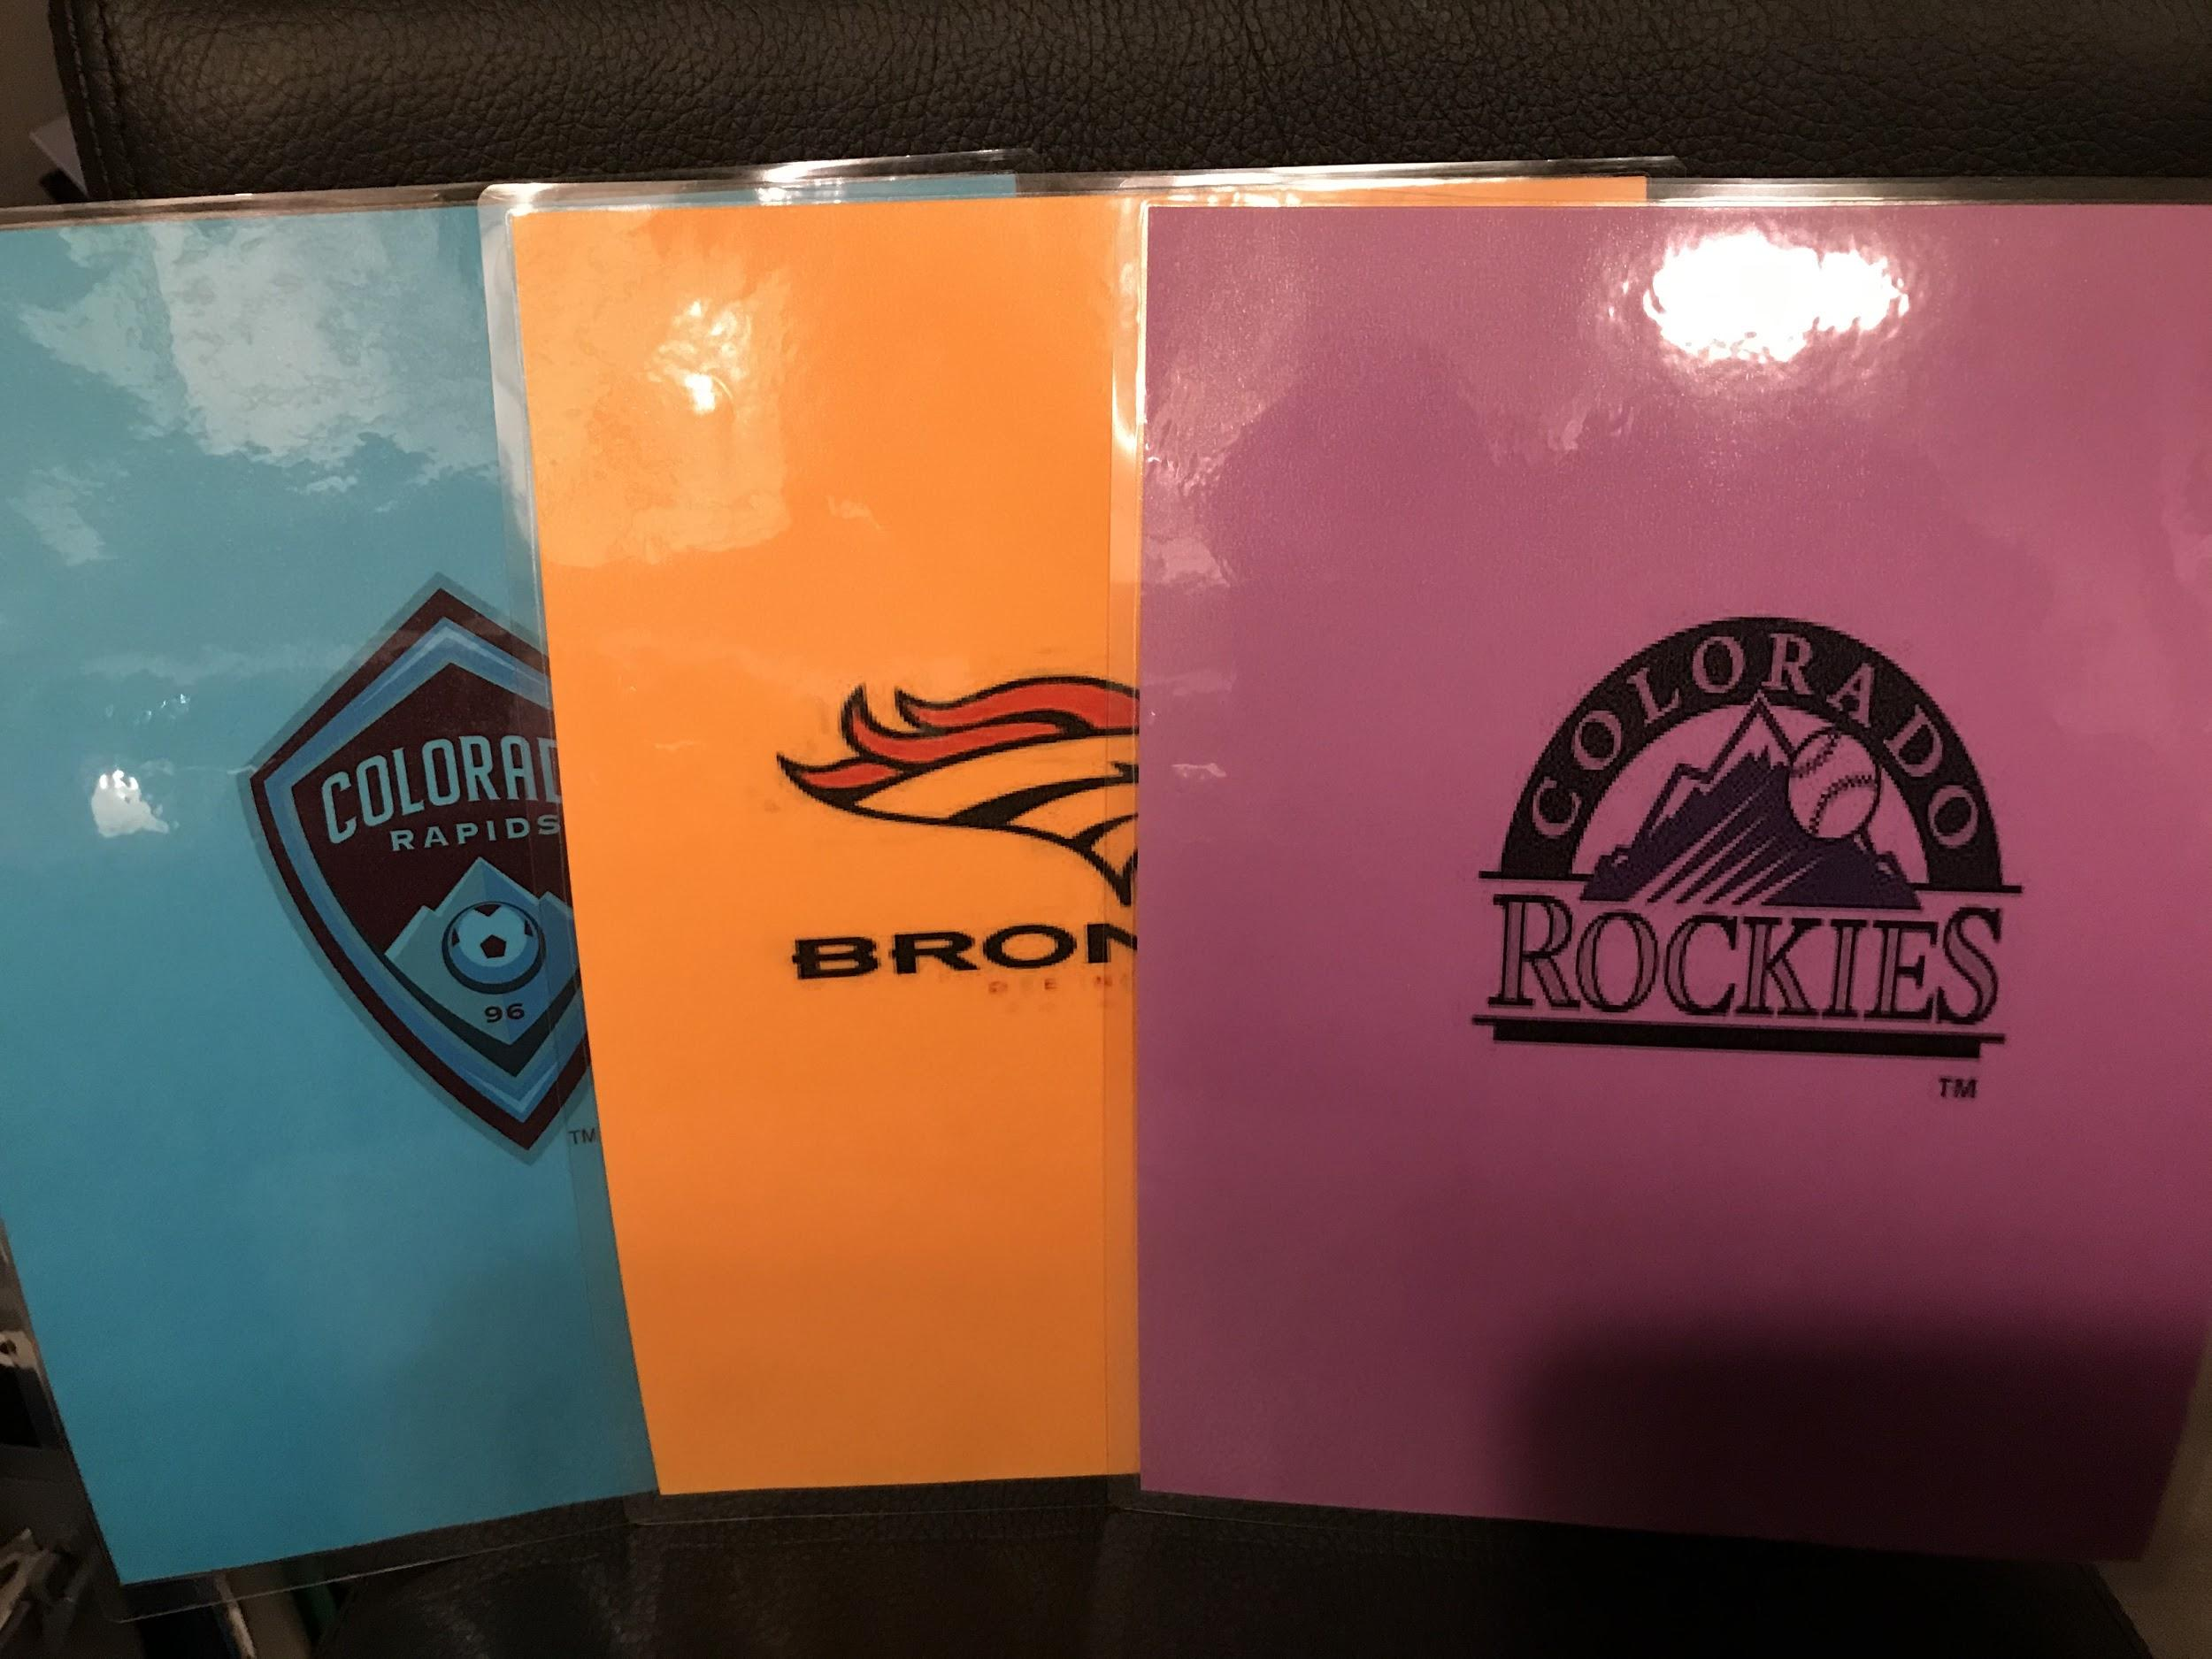
We will all have a Group!

Slide 27
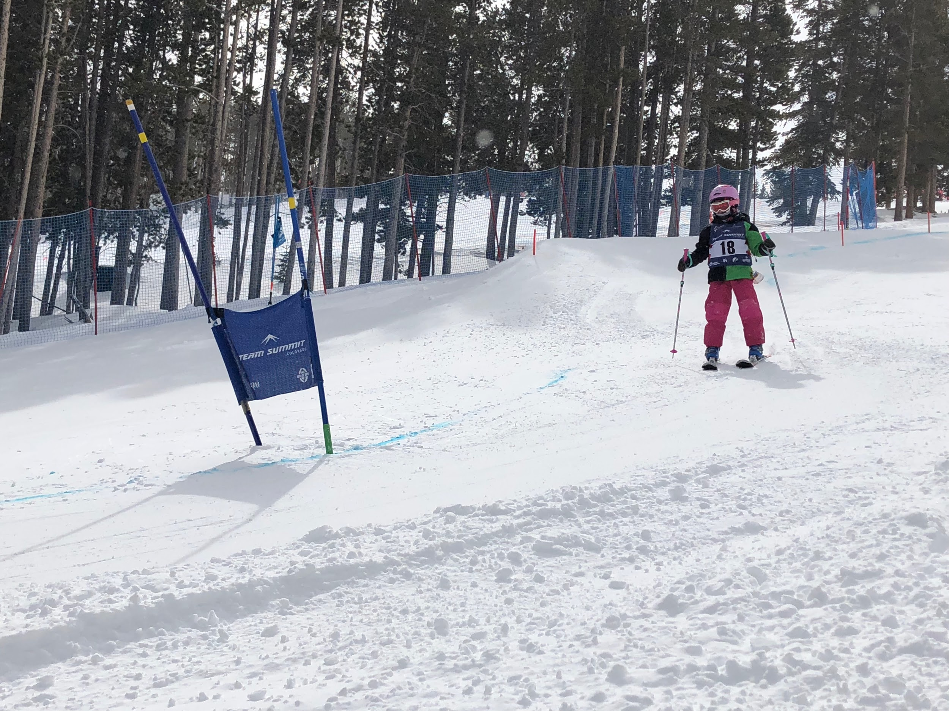
Summit Cups

Slide 28
Summit Cup Events
Summit Cup Events are held on four Sundays throughout the season, and are open only to introductory level athletes.
Various competitive disciplines
GS/ SL - January 12th, Keystone
Big Mountain/Moguls - January 26th, ABasin
Skills Cross- February 23, Breck
Park/Pipe - March 1st-Copper
Sundays (do not conflict with the regular Saturday training schedule)
Fact Sheet (all logistical information for the upcoming competition)

Slide 29
Bonus Training Prior to Summit Cups
Bonus Training will be held on the Sunday before each event.
GS/SL training - January 5th
Big Mountain/Moguls - January 19th
ITS coaches will be involved with these trainings combined with IFS and ITR programming.

Slide 30
ITS Calendar
Teamsummit.org
Calendar
Intro to Team Summit
https://teamsummit.org/join-team-summit/programs/intro-team-summit

Slide 31
Connecting with Team Summit Colorado
teamsummit.org
Your resource for all Program and Team information

Slide 32
Questions?

